Slide 1
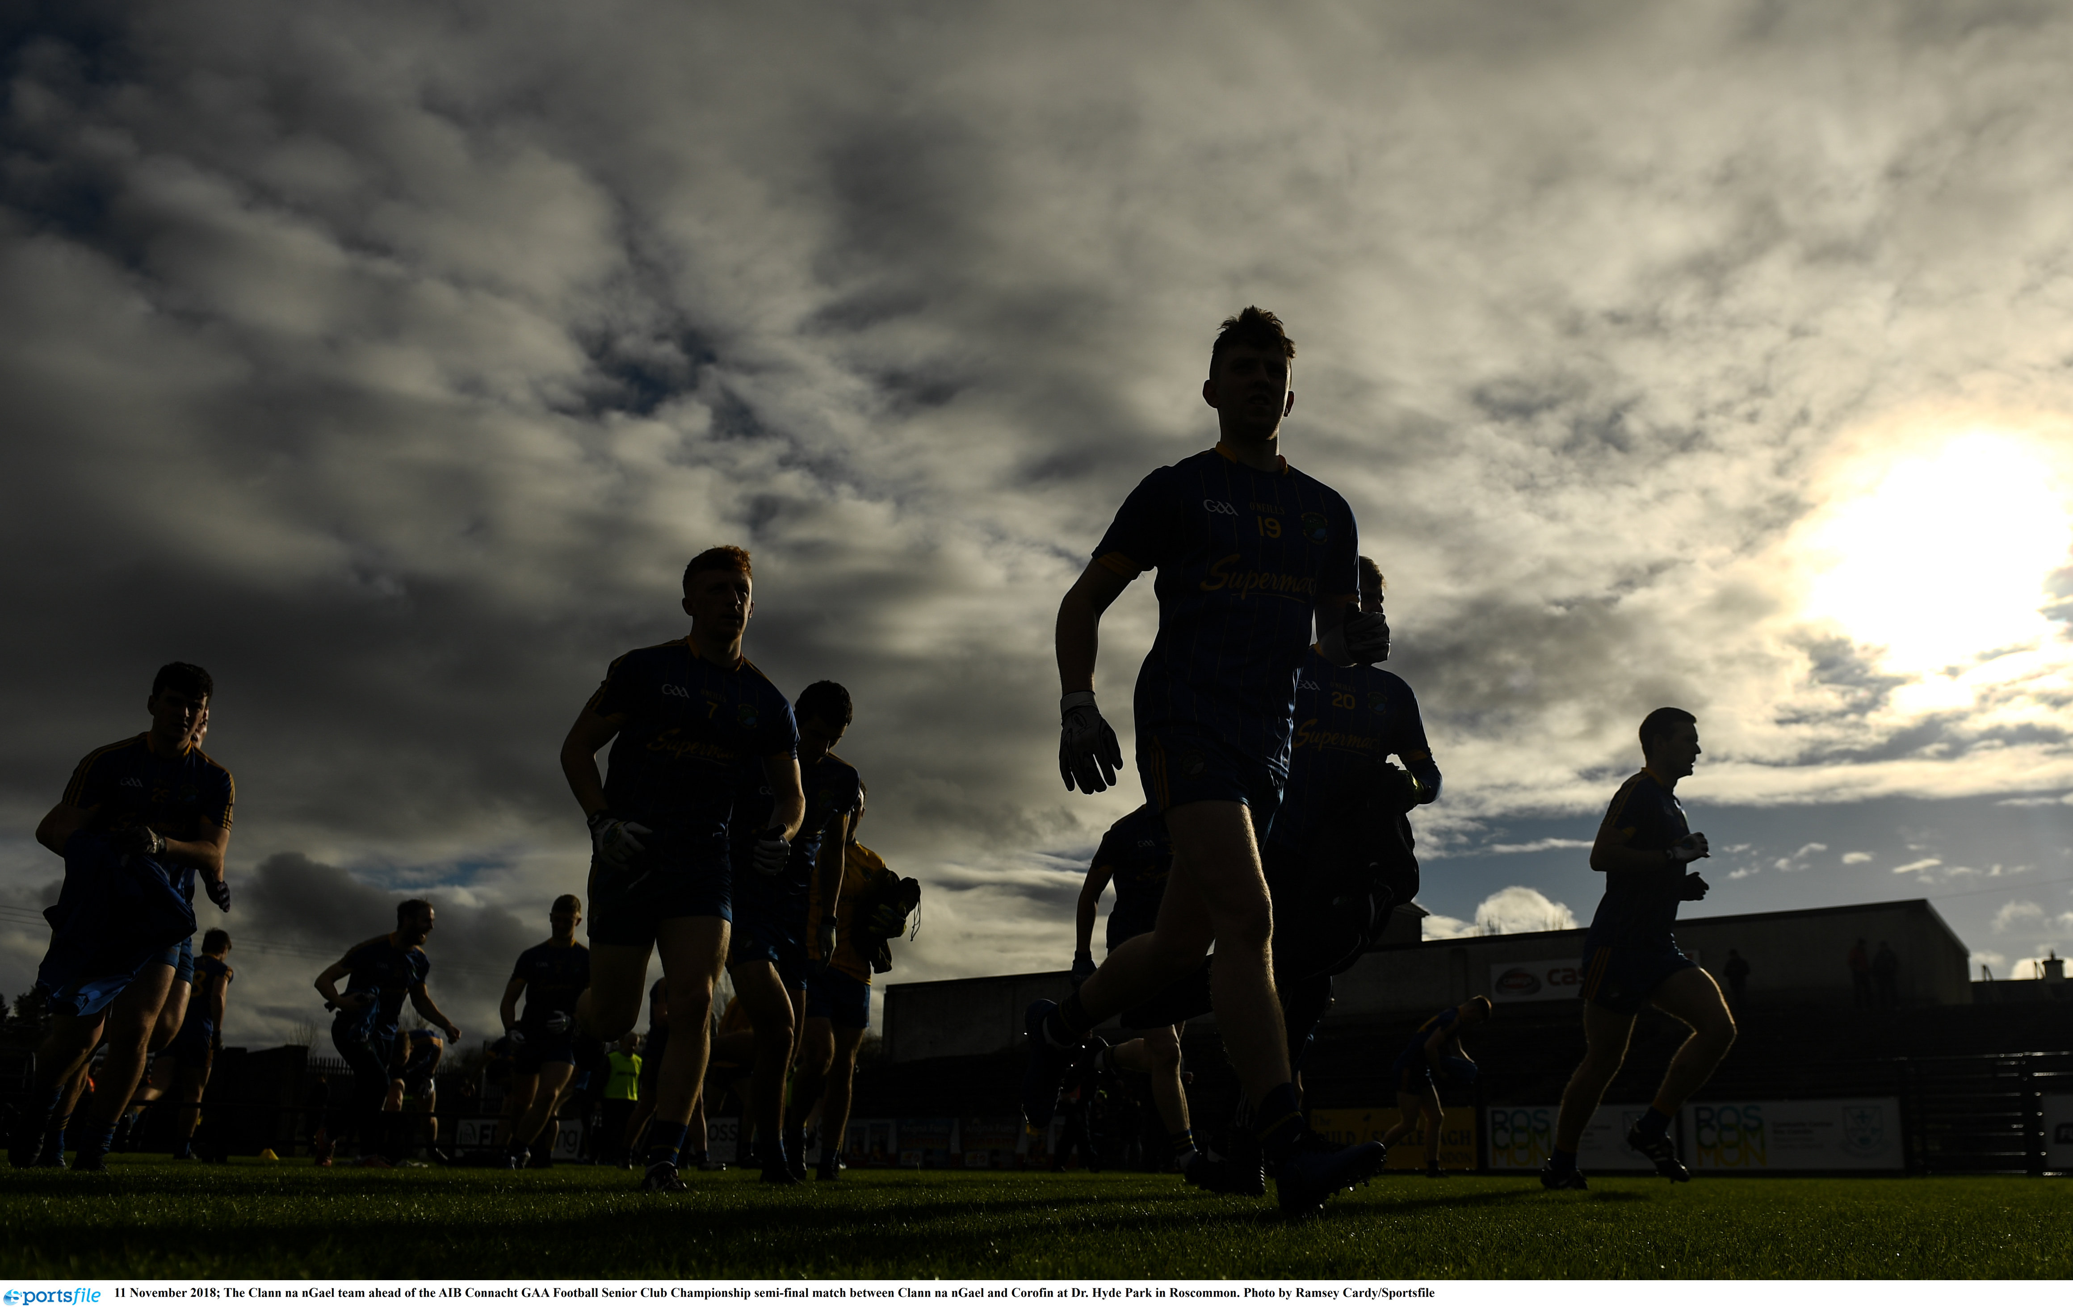





Slide 2

OVERVIEW
What is Club Compás and why are we developing it?

Slide 3

Club Compás helps Clubs assess their ‘Off the Field’ performance, across the six ‘pillars’ of a well-run Club, using a purpose-built online tool. After updating, a Club can use their Club Compás to address their gaps and double-down on their strengths.

Slide 4
Pillars
Games
People
Community
Comm’s & PR
Governance
Resources

Slide 5
Pillars
Games
People
Community
Comm’s & PR
Governance
Resources
122 Criteria
18 Categories
3 Levels

Slide 6
Criteria defined by Associations, departments and/or Central Council Sub-committees
Based on rules, policies and best practices
Specific to Club type e.g., One Clubs, GAA only etc.
Assigned a priority level…
Must Do
Mandatory activities set out in the Official Guide or Central Council policies
Should Do
Good practices that are important to do, but are not mandatory
Could Do
Nice-to-do’s that would have a minimal impact on the Club if not done

Slide 7






Why have Club Compás?
Encourages better planning
By providing Clubs with insights into their current performance and resources to guide action planning conversations among the Club Executive and Sub-committees.
Improves governance standards
By increasing awareness and adoption of the key rules, policies and tasks relevant to all Clubs.
Lightens workload
By streamlining the information and documentation Clubs are routinely asked to provide to Counties, Provinces, Central Council, etc.
Enables evidence-based decisions
By gathering data on Club performance to inform planning and resourcing decisions and helping Clubs to benchmark their performance against other Clubs.
Recognises good practice
By giving them valuable rewards in recognition of their commitment to good governance.
Promotes a more complete approach to development
By looking at the Club in its entirety, Club Compás ensures Clubs are developing sustainably and all six core areas of the Club are interdependent

Slide 8
HOW IT WORKS
How do we all use and benefit from Club Compás?

Slide 9
Start Point
A
B
Self-Assessment
Accreditation
Benchmarking
Action Planning Process

Slide 10
Club Compás Status?
Log into Foireann
Open Club Compás
Criteria response entered
Never Engaged
Previous Engagement
Required Evidence Attached?
Existing Assessment
Update criteria as required
Apply for Official Assessment
Yes
No
Self-Assess Status Provided
Evidence Reviewed
Renewal
Yes
Mandatory
Facilitated Action Planning?
Minimum status?
Assessed Status Confirmed
End
No
Optional

Slide 11
Club Compás Status?
Log into Foireann
Access Club Compás
Criteria response entered
Never Engaged
Previous Engagement
Required Evidence Attached?
Existing Assessment
Update criteria as required
Apply for Official Assessment
Yes
No
Self-Assess Status Provided
Evidence Reviewed
Renewal
Yes
Mandatory
Facilitated Action Planning?
Minimum status?
Assessed Status Confirmed
End
No
Optional

Slide 12
Club Compás Status?
Log into Foireann
Access Club Compás
Previous Engagement
Required Evidence Attached?
Existing Assessment
Update criteria as required
Apply for Official Assessment
Yes
Application Submitted
Admins Notified
Assessor Appointed
Assessment Completed
Assessment Confirmed
Club Status Updated
Club Notified
Award & Recognition
Evidence Reviewed
Yes
Facilitated Action Planning?
Minimum status?
Assessed Status Confirmed
Optional

Slide 13
The Assessment Process
Appointed Assessor logs into Foireann to access application for assigned Club
Assessor reviews assigned criteria and associated evidence within Foireann
Each criteria is marked as approved or…
More information needed with advice on how to address
All criteria is assessed - regardless of individual criteria outcome
Any application not meeting requirements is sent back to Club for amendment
Resubmitted applications reassessed – relevant criteria only

Slide 14
Club Compás Status?
Log into Foireann
Access Club Compás
Previous Engagement
Required Evidence Attached?
Existing Assessment
Update criteria as required
Apply for Official Assessment
Yes
Application Submitted
Admins Notified
Assessors Appointed
Assessment Completed
Assessment Confirmed
Club Status Updated
Club Notified
Award & Recognition
Evidence Reviewed
Yes
Facilitated Action Planning?
Minimum status?
Assessed Status Confirmed
Optional

Slide 15
Rewards & Recognition
Helps a Club maintain – or upgrade – their Compás level
Promotes Club Compás and a Club’s effort in achieving it
Is most applicable to Clubs who are going beyond mere compliance

Slide 16

Rewards & Recognition
 | Bronze | Silver | Gold | Platinum
Plaque
Certificate
Banner
Digital brand pack
Club Compás ‘Bosca Fáilte’
Professional Photos
Expanded supports
Compás Case Study
Recognised at County Level
Recognised at Provincial Level
Recognised at National Level

Slide 17
Rewards & Recognition
 | Bronze | Silver | Gold | Platinum
Invited to County Awards Night
Invited to Provincial Awards Night
Invited to Club & Volunteer Awards
Conference Discounts
Showcased at Conferences etc.

Slide 18
WHAT’S NEXT
Short-, medium- and long-term plans for Club Compás

Slide 19
Launching Accreditation
Foireann Development
Status:
Criteria Updates:
Completed
Launch:
In Progress
Club Submissions Commence:
Pending
Assessor Upskilling:
Assessments Ongoing:
Feedback Collected:
Awards Issued:

Slide 20
The Next Phase
Self-Assessment
Accreditation
Benchmarking
Action Planning Process

Slide 21
Benchmarking
Overall Club Ranking
Member Registrations
Player Registrations
Club Type
Specific Counties / Provinces
Catchment Areas

Slide 23
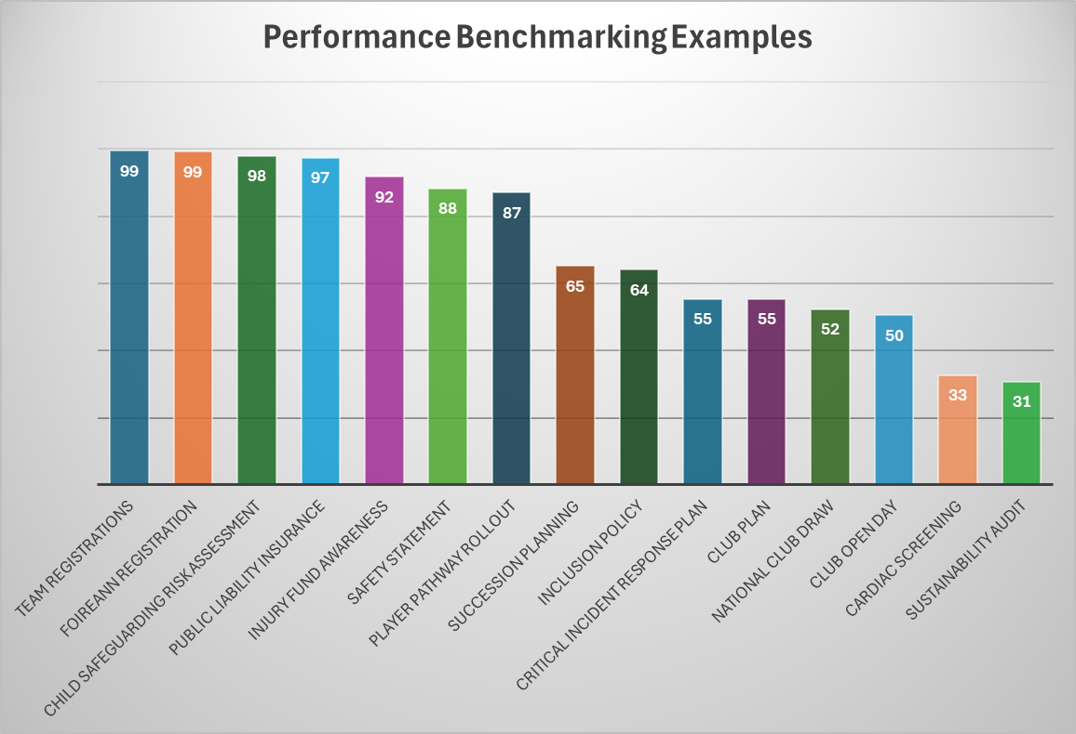

Slide 24

Go Raibh Maith Agaibh

