Slide 1
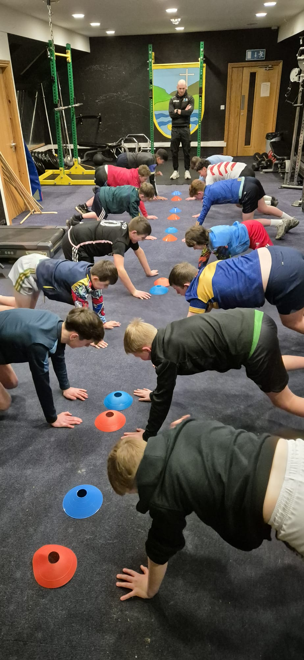

Emerging Player Programme Portroe GAA
Paudie Malone GDC Tipperary

Slide 2
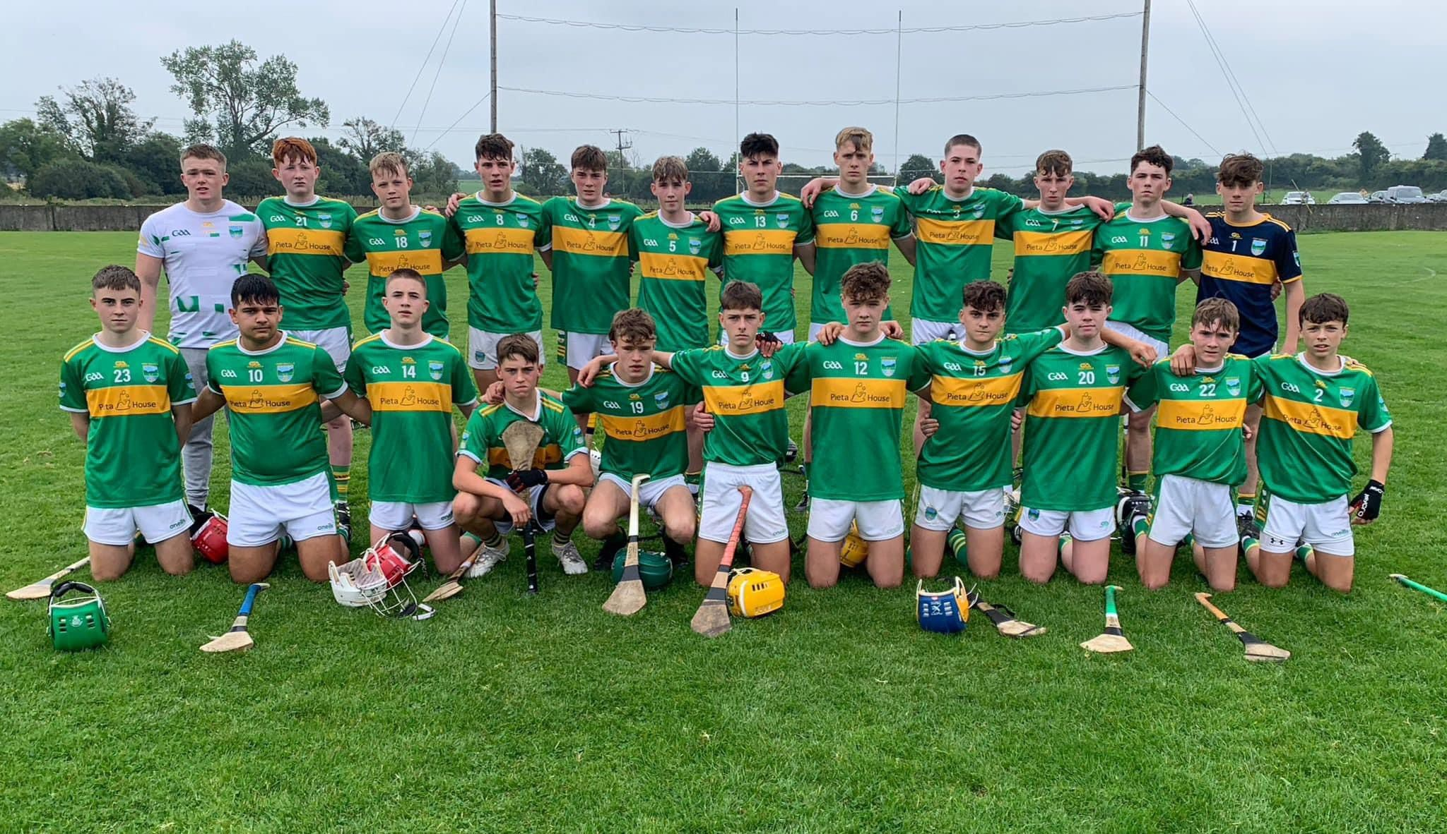
Insight- Portroe GAA
Small rural club outside Nenagh
Population 460 people (65% population or 292 people are 30+)
U17 Manager 2024
Club have dropped from Senior to Intermediate grade in the last 10 years
48 players aged between 13 to 18 registered in the club
U13 (C), U15 (B), U17 (B)
In the last 3 years only 4 players have come through to play on the 1st adult team.

Slide 3
Reasons for Programme
17 year old transitioning to the adult game too young
Trying to replicate an ‘A’ club environment in a B/C graded club
Create a culture around personal responsibility and understanding the requirements to thrive not survive in the adult game
Get players to the adult first team quicker
Develop the person as well as the player
Retention of youth players transitioning to adult game

Slide 4
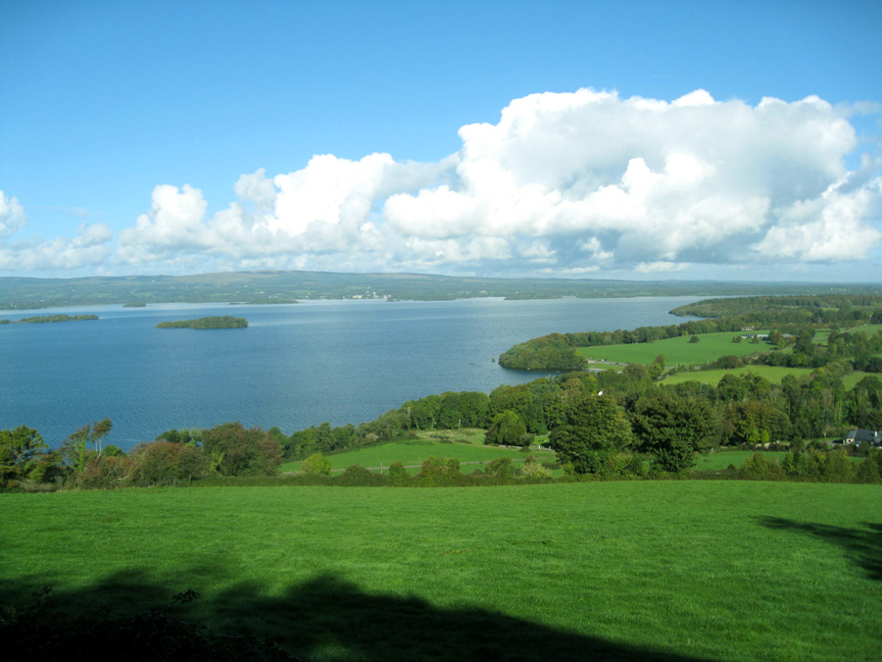
Committee
Tom Gallahue (Senior Chairperson)
Mike Donnellan (Juvenile Chairperson)
Darren Gleeson (Coaching Officer)
Liam Sheedy (U21 Manager)
Damien Ryan (Intermediate Hurling Coach 2024)
Paudie Malone (U17 Manager)

Slide 5
Programme
Athletic Development
Running Mechanics
Mentorship
Workshops

Slide 6
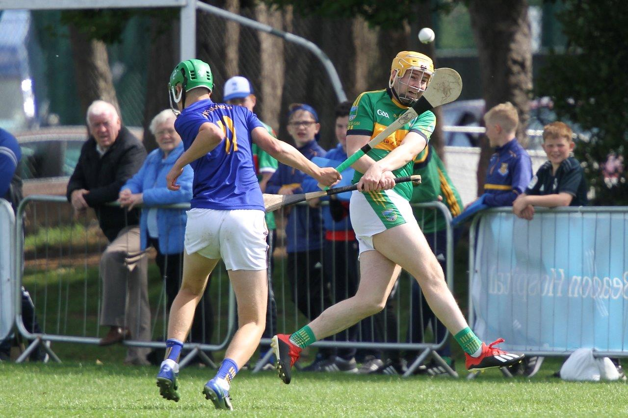
Aim of Programme
To give young players in our club a programme that prepares them for adult competition before attending sessions with the senior adult team.
To give our 17 year olds transitioning out of juvenile a voice, a base a chance to compete through our mentorship side of the programme.
To create a culture of personal responsibility in our future adult players around preparing both physically and pschologically to play the game.
Instil Culture & Identity

Slide 7
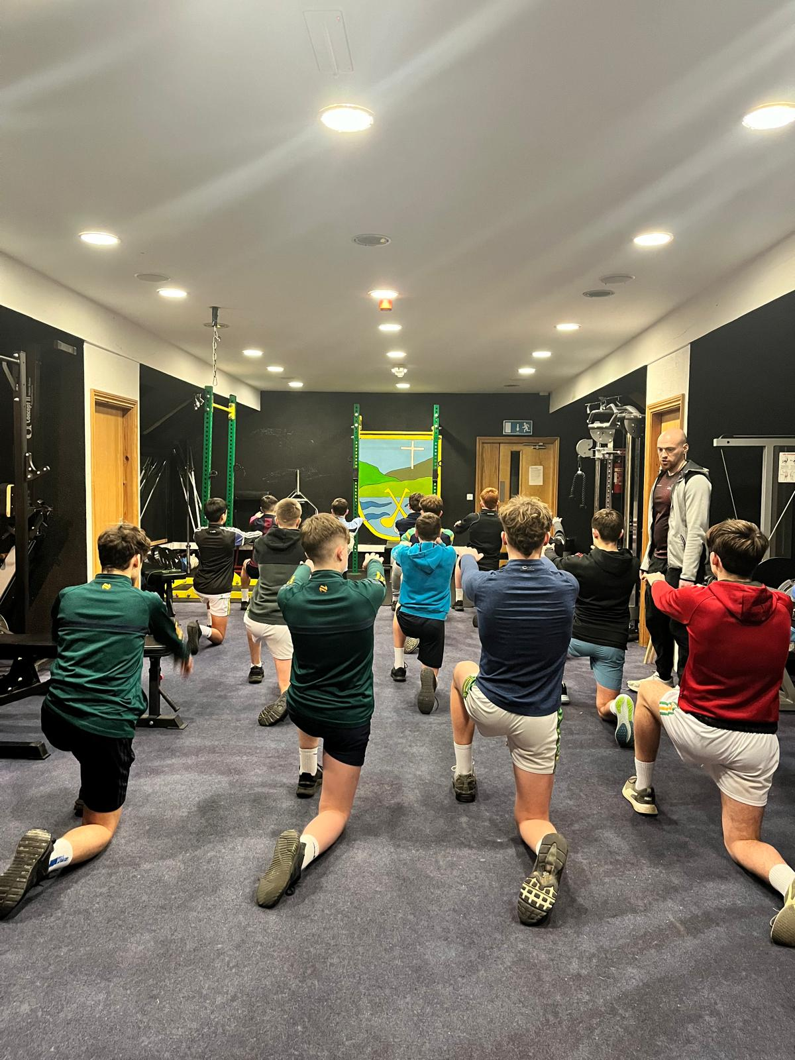
Athletic Development
Youth Players 13- 19
2 nights a week (off season)
1 night a week (In season)
3 Groups 6.30pm to 9pm
Testing (3 times a year)
Record of Attendance

Slide 8
Player Progression/Testing
Height & Weight – Player Maturation
Lower limb power – Counter-Movement Jump
Acceleration – 10m
Strength – Front squat, Bench, Chin-ups
Fitness – 1.2Km

Slide 9
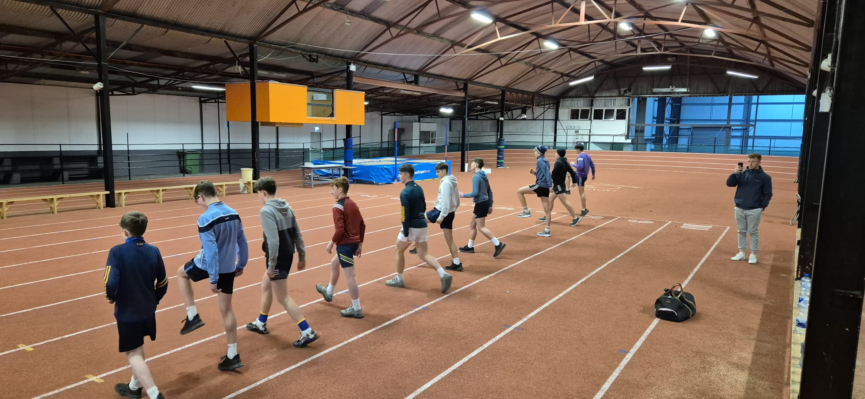
Running Mechanics
Nenagh Running Track
Qualified Athletic Coach
Starts in January (8 weeks)
Once a week
Focus on running mechanics

Slide 10
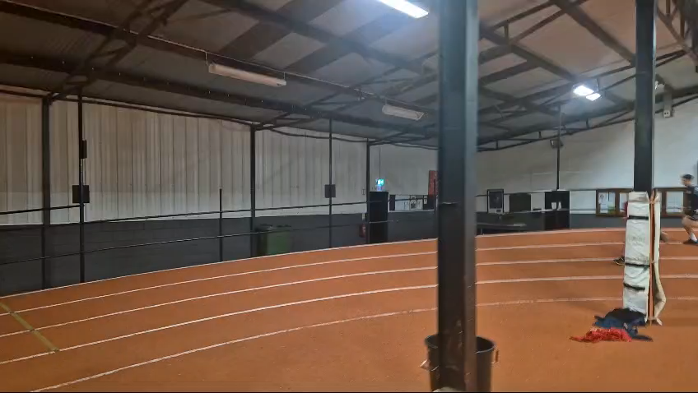
Track Work 1

Slide 11
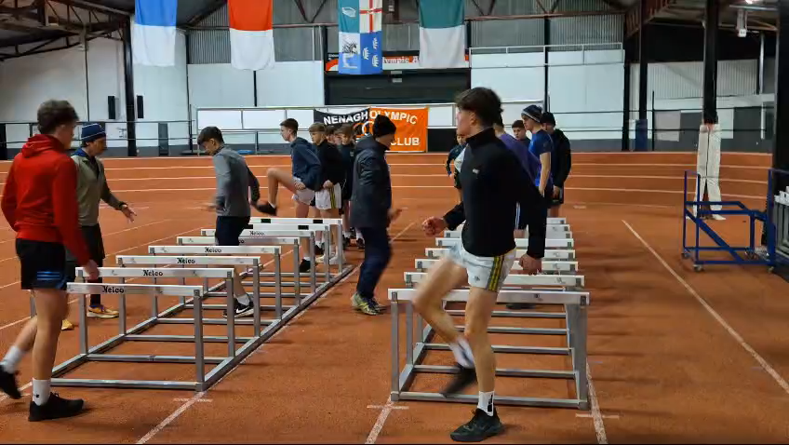
Track Work 2

Slide 12
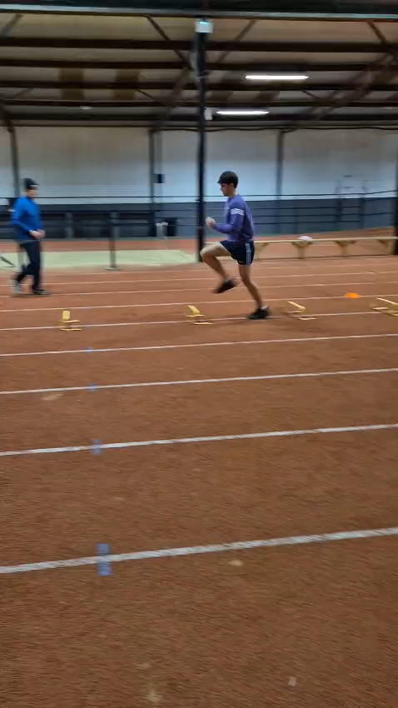
Track Work 3

Slide 13
Mentorship
Guidance transitioning players from juvenile to adult training next year.
Instil qualities in the players around leadership, personal responsibility and identity.
Creating a high performance mindset, improving environment and culture.
A voice for the players when entering the adult game
A source of information for next year's Intermediate manager about these players

Slide 14
Workshops
1. Nutrition (January)
2. Culture & Identity (February)
3. Drug Awareness (February)
4. Basic Goalsetting & Mindset (March)

Slide 15
Costing
Athletic Development Coach- Twice a week in the winter and once a week there after for three 45 min slots - €90 per night – Total €5,760 (64 sessions)
Nenagh Indoor Track w/ Coach once a week for 8 weeks 45 mins- €1,500
Various Workshops- 4 workshops- €1,000
Gear for the players involved in the programme max of 45 players each year - €2,500
Total cost to club- €10,760

Slide 16
Funding the Project
Retired players fund €50 per player, target 60 players - €3,000
Juvenile Spinathon- Each players sells lines then they cycle for 24hrs outside local shop. Two 12hr days. Players involved in the programme allowed to do it. 45 players. Toal amount on card €50 x 45 plus collection at the stand - €3,500
Look at increasing membership for juvenile players to offset the cost. Before raising the money have an information night in the hall around what we are planning to do - €2,000
Potential sponsor for the Programme €2,500

Slide 17
End Goals/Progressions
To transition more players to the 1st adult team in the next 3 years
To retain more players in the juvenile system in the club
To get more players on divisional and county squads.
To offer more than just ‘training’- social, learning and fun environment
To create a self-sufficient player that in the future as an adult will have the techniques to work on his own
Tie in lifestyle programmes- Homework Club, Grinds, Link in with local youth club

Slide 18
January 2025 Update
40 out of 48 players attending regularly
Players born in 2012 too young for programme, would start at 2010 players if I was to start again
Players pay €5 a night for athletic track so no cost on club
Including club coaches in the track and gym nights to learn and also running a specific warm up routine with all squads from u13 to u17 in the club through our S&C coach
Workshops Jan- Nutrition, Feb- Culture & Identity, Feb- Drug Awareness, March-Basics of Mindset

