Slide 1

Loughmore Castleiney GAA Club
Juvenile Coaching - Challenges & Opportunities

Slide 2
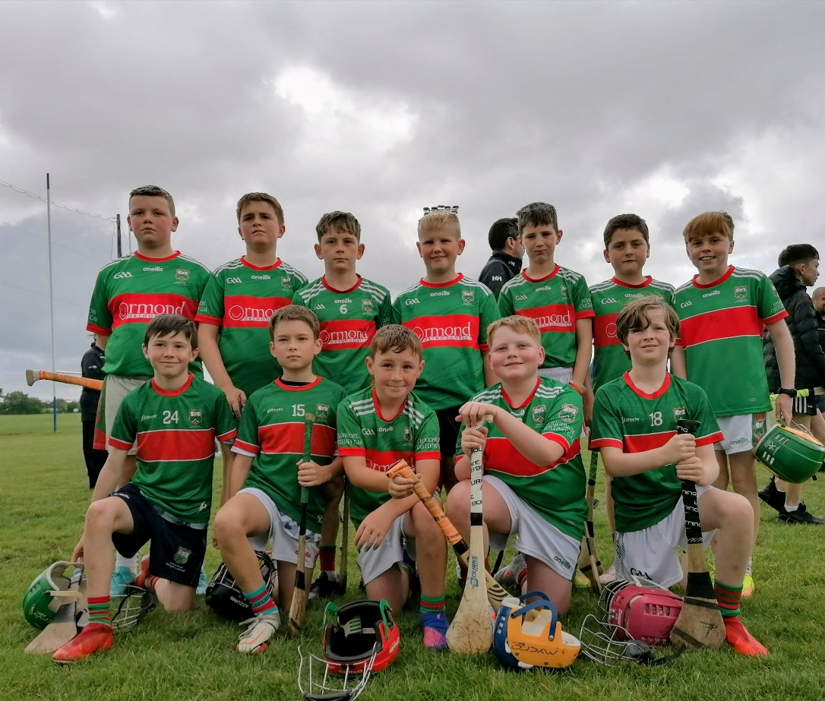
A Brief History
Club founded in its current format 1964.
Population 1000 people approximately.
2 national schools.
Currently the smallest juvenile club in the Mid Tipperary Division.
Number of members U17 years <100
2024 adopted one club policy.

Slide 3
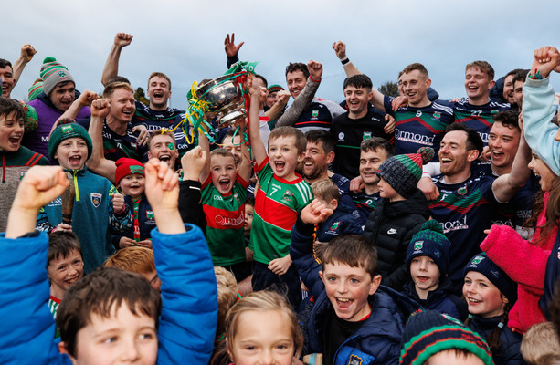
Why was 2024 a successful year?
An overnight success years in the making.
A unique group of players.
History of success from underage in both codes.
Based on strong families.
Player longevity – preparing the ground.

Slide 4
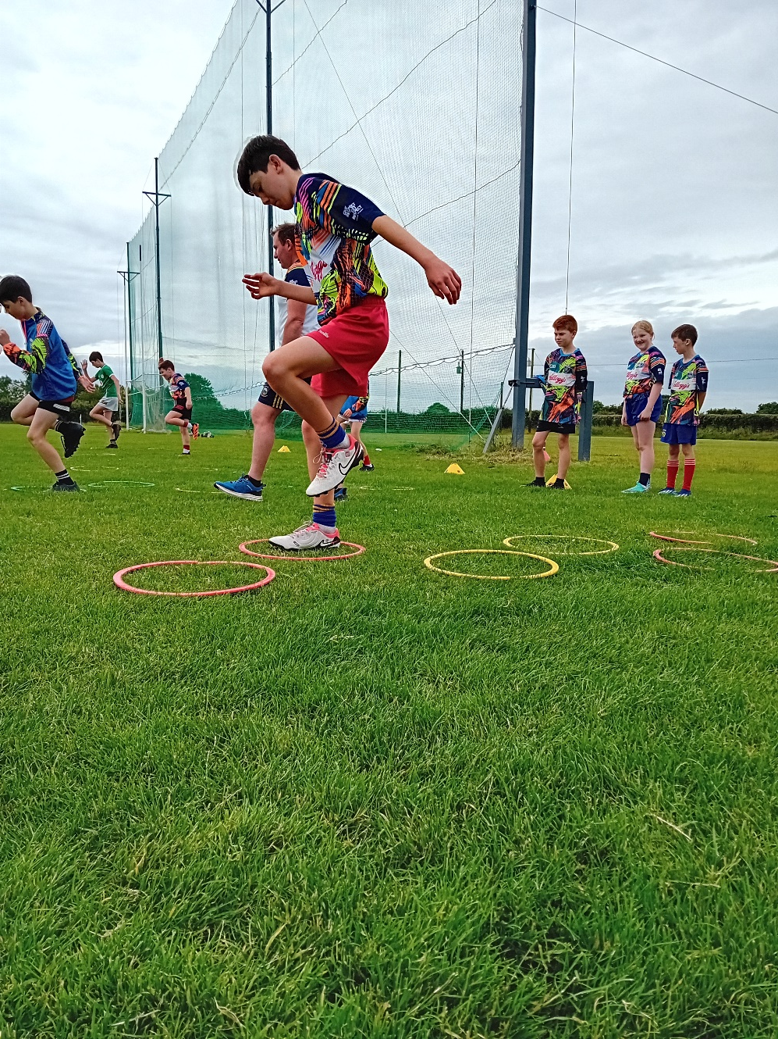
Challenges & Opportunities
Maximising Resources
Current challenges
Very small playing/coaching pool.
1 boy at U9 for 2025.
2025 club grouping at U17 and U19.
No girls teams
Retention
The upside!
Everyone knows everyone.
Co-dependence between age groups and coaches.
Coach to player ratio.
More game time – small panels
Tracking progress and involvement

Slide 5
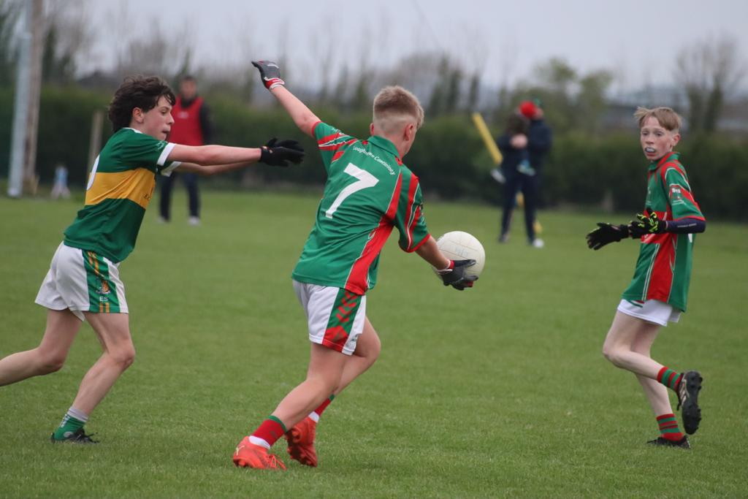
Best Practice in Development
2 guiding principals;
Maximising participation - adults & children.
Every child is important.
How to achieve these – 5 keys.
DUAL commitment – increase participation
Parental involvement – a challenge.
Presence in the schools – cooperation required.
Current/former adult players
Adhering to policy – potential barrier.
Coaching the coaches – availing of supports offered by County Board

Slide 6
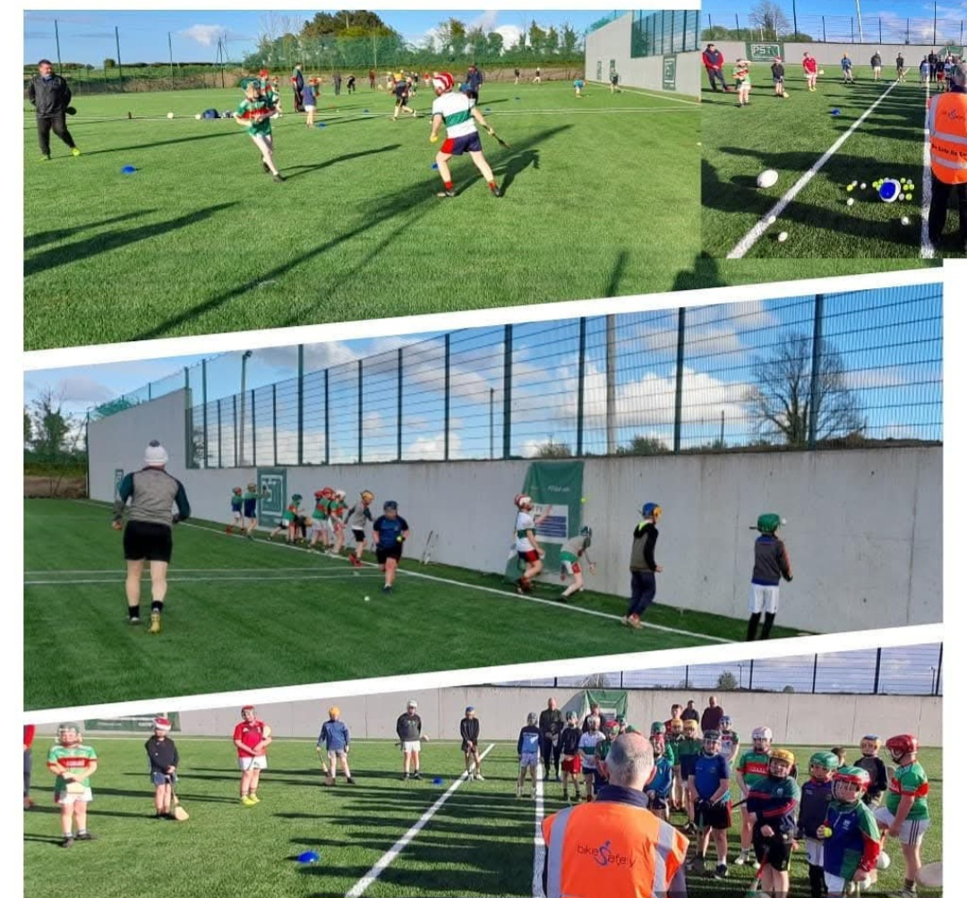
Performance Indicators
Players & Coaching Staff
How many continue to play?
Major drop off after 17 in recent years.
Fielding competitive teams a priority.
A major challenge for certain age groups in recent years.
2024 U17 played in ‘C’ competition. Accelerates drop off.
2025 Club grouping – a new departure.
Coaching pool to meet best practise.
Overlap in coaching staff.
2023 Foundation Course over 30* in attendance.
Investment in facilities

Slide 7
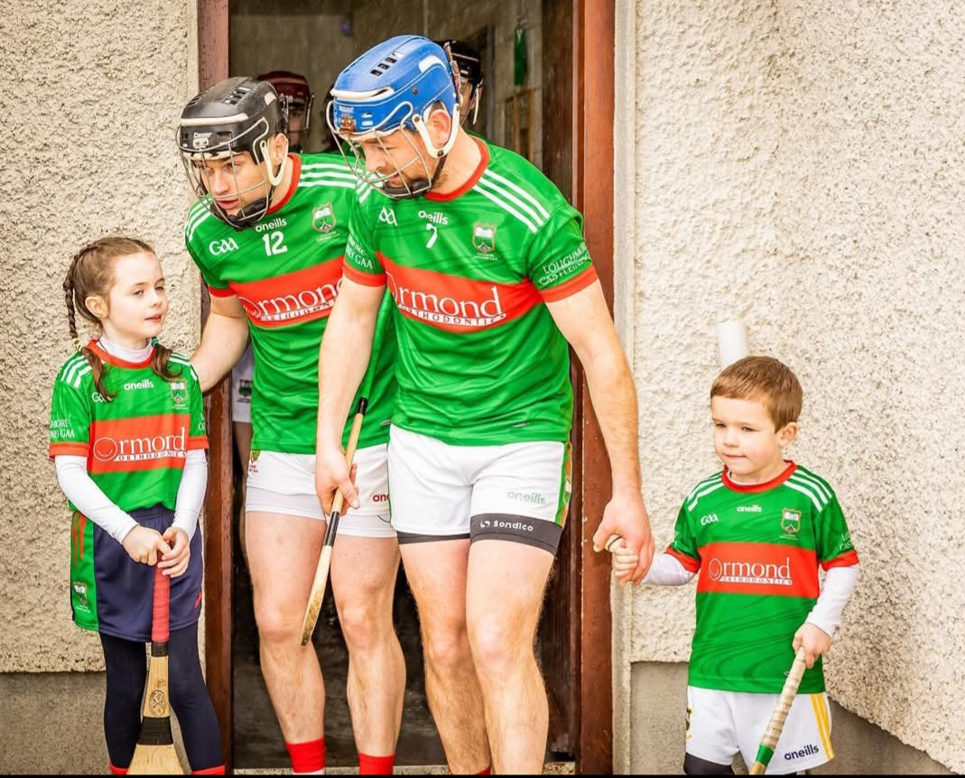
Pathway from Juvenile to Senior
Friendly and welcoming environment.
Juvenile & senior teams – shared evenings
15 years + involved with backroom staff.
Over 17s train with adult club, senior and junior.
2024/25 U13+ use same S&C as adults.
U19, U21, Junior C, Junior A & Senior team – opportunity to play adult.

