Slide 1
Coaching & Administration Working as a Team
Presenters
John Brennan – Munster GAA Operation Manager & member of the provincial and National Planning & Training Operations Groups
Seamus Twomey – Chairperson Munster Club and County Planning Workgroup

Slide 2
Areas we will cover
Munster GAA club officer training modules
Club Compás
Benefits & examples of the criteria
Club planning process
What it is, the process, areas of focus, coaching plan considerations, support resources available.
Sources of information
Take away actions & support networks

Slide 3
Club Officer Training
Munster GAA held club officer training online on the 16th January 2025, this is an annual event designed to support club officers in their appointed roles.
Areas covered included:
Chairperson
Secretary
Treasurer
PRO
Coaching officer
Notes:
All seminar were recorded and the details are available to view online via the GAA eLearning portal.
https://learning.gaa.ie/search/all?keys=&f%5B0%5D=category%3A3552

Slide 4
Chairperson training
2. Your role as Chairperson
3. How to make your Club better
4. How to get good people involved
5. Managing meetings
6. Where to get more support and information
1. What a well-run Club looks like

Slide 5
Secretary Training
1. Role Overview
4. Effective Meetings
6. Additional Resources and Supports
2. Communication
3. Administration
5. Club Planning

Slide 6
Treasurer Training
2. Your role as Treasurer
3. Financial Management
4. Governance
5. Sources of Funding
6. Where to get more support and information
1. What a Financially well-ran Club looks like.

Slide 7
PRO Training
1. The role of a Club PRO
2. Promoting your Club and the Association as a whole
4. Digital and social media
5. Traditional media
6. Supports and resources
3. Effective communication

Slide 8
Coaching officer training
1. Responsibilities of the Club Coaching Officer 2. Skills and qualities needed for the role 3. Creating a Games Development Plan 4. Overview of Player and Coach Development framework and policies 5. Methods to engage with Clubs 6. Creating a community of practice in the Club 7. Where to get support and more information

Slide 9
1. Self-Assessment
2. Club Report
3. ACTION Planning
4. Coming Soon: Club Accreditation
The Club Compás is a new online self-assessment tool that gives Clubs direction to improve their ‘off the field’ performance.
Notes:
The Club Compás is an online self-assessment tool that gives Clubs direction to improve their ‘off the field’ performance.
It was launched in March 2023 and is available to all Clubs within Foireann.
Its features are:
1. Self-Assessment
Each Club can complete a self-assessment of their Club’s performance against over 100 criteria.
2. Club Report
Each Club then receives a report containing Club-specific advice and resources to inform action planning conversations.
3. Action Planning
Each Club can then prioritise issues with the Club Executive and develop an action plan to address operational shortcomings.

Slide 10
Club Compás Benefits
Encourage Club Planning
Provide Clubs with insights to their current performance and resources to guide action planning
Improve Club Governance Standards
By increasing awareness and adoption of key rules and policies
Simplify Volunteer Workload
Streamlining the information and documentation Clubs are routinely asked to provide
Support Evidence-Based Decisions
By gathering data on Club performance to inform planning and resourcing decisions and helping Clubs benchmark their performance
Reward Clubs
By giving them valuable rewards in recognition of their commitment to good governance
Notes:
Explain the key benefits for Clubs

Slide 11
Example of Criteria
Coaching Officer Appointment - Does your Club have an elected Coaching Officer?
Club Referee - Does your Club actively encourage members to get involved in refereeing and/or officiating?
Codes of Behaviour (Underage) - Has your Club adopted the Gaelic Games Code of Behaviour (Underage)?
Correspondence - Does your Club ensure that all official Club correspondence comes through the Club Secretary, or if absent, the Assistant Secretary?
Club Executive Names - Does your Club confirm the names of the Executive Committee annually via Foireann?
AGM Timing - Does your Club Executive Committee hold the AGM each year before the due date specified by the GAA/LGFA/Camogie Association, as appropriate?
Sports Tax Exemption - Has your Club registered for sports tax exemption?
Notes:
Explain that these are some of the criteria that the Club Compás uses to measure each Club’s performance

Slide 12
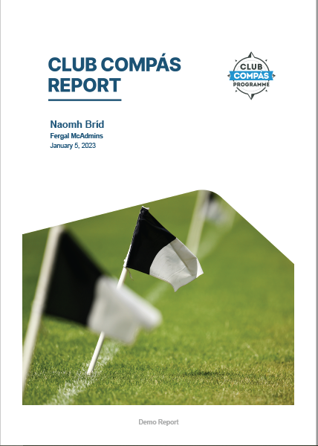
Next Step
Learn more about what is involved by visiting learning.gaa.ie/clubcompas
The tool is now live via each Club's Foireann account
This may encourage clubs to consider drafting a strategic plan

Slide 13
Club planning Programme
What is it?
The Club Planning Programme offers a step-by-step approach to developing a strategic plan for GAA, LGFA, and Camogie Clubs. It includes a Club Planning Guide, templates, and trained Facilitators to assist Clubs navigate the planning process.

Slide 14
Key Areas Of Focus
Coaching and Games Development
Commercial & Sponsorship
Volunteer Recruitment & Retention
Infrastructure
Governance & Administration
Communication & Marketing
Finance & Fundraising
Health & Wellbeing

Slide 15
Club Planning Process
Getting started
Doing the groundwork
Creating a strategy
Writing the plan
Achieving results
Notes:
Getting started
Clubs express their interest by submitting an Expression of Interest form
The Steering Group and Club Coordinator are appointed by the Club Executive
The Club Planning Facilitator has an introductory discussion with the Club Coordinator
Doing the groundwork
The Steering Group creates a project plan to outline actions and responsibilities
The Steering Group assesses the Club's current performance by reviewing key documents and data
Key Focus Areas (KFAs) are identified based on the Club’s challenges and opportunities
Creating a strategy
The independently facilitated Club Planning Workshop is held to gather input from Club members and the community
The Steering Group considers feedback from the workshop focus groups and prioritises objectives
Further research can be conducted, such as surveys and meetings with experts, to identify solutions to issues
Writing the plan
The Steering Group writes the strategic plan document
The plan should be reviewed multiple times and approved by the Club Executive
The document is launched and communicated
Achieving results
After the plan is launched, the Club Executive assumes responsibility for implementation
They establish procedures for implementation, review progress regularly, and communicate achievements

Slide 16
Coaching and Games Development planning
Appointing a Coaching and Games Development Sub-Committee and giving them terms of reference for their role
Creating a Club C&G Cultural
Club Coaching Officer
Expand the Games Programme for all Members
Create an integrated player development journey
Inclusive and accessible approach
Coach Education
GAA Code of Best Practice and Code of Behaviour
Club/School Link
Address participation gaps or capitalised on souring underage membership numbers
Notes:
The areas listed are some of the key areas commonly considered when developing a coaching and games development.
Each club will be different in the challenges that they face and the areas being selected should be tailored to the club needs. E.G. An urban club’s challenges will very much vary from that of a rural club mainly due to participation numbers.

Slide 17
Club Planning Resources available
Club planning guide
Expression of interest form
Readiness assessment form
Terms of reference for steering group
Role profile for club coordinator
Project plan templates
Club activity checklist
Club plan templates
Experienced facilitator provided by the association to guide clubs through the process
All available from; https://learning.gaa.ie/clubplanning

Slide 18
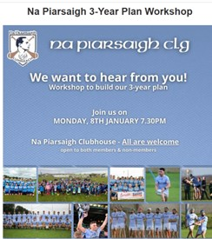
Examples of strategic plans
Example of previous club strategic plans can be found on: https://learning.gaa.ie/previousclubplans

Slide 19
Audience engagement
Does your club have a strategic plan?
Is the plan actively reviewed and acted upon?
What benefits does the plan bring to the club?
What are the challenges encountered in keeping to the plan?

Slide 20
6. Where to get more support and information

Slide 21
Sources of information
Fellow and Previous Club Officers
County Board officers
Official Guide and Club Constitution
Club Support Manual
GAA eLearning Portal
Central and Provincial Staff
LGFA County Development Committee
Camogie County Development Committees
Notes:
SCRIPT
Fellow and Previous Role Holders
Great source of advice. Encourage officers to share ideas and solve problem with each other
County Secretary/ planning & training officer
The County officers are there to serve Clubs therefore don’t hesitate to contact him/her if you have a query or need support.
Central and Provincial Staff
Refer officers to the lists of contact details on the Learning Portal for the GAA, LGFA and Camogie Association
Official Guide
Contains the Constitution and Rules of the G.A.A.
Covers everything from the disciplinary procedures to vesting of property and anti-doping rules.
Visit the GAA website to access it
Club Constitution
The Official Club Constitution and Rules shall govern the affairs of all Clubs
Provides a framework whereby the GAA Club can be operated and managed by the Executive Committee of the Club
See Appendix 5 of the Official Guide
Club Support Manual
The GAA’s Club Support Manual contains essential information in relation to club administration and management
Due to the breadth of information which it contains, each section is available individually on the GAA’s Learning Portal
You should take time to review sections of the Manual which are relevant to your role
It would be an idea to discuss specific sections at Club Executive meetings under the heading ‘Improving our Club’
Available online at learning.gaa.ie/administrator
GAA Learning Portal
The GAA’s Learning and Development Community portal contains a vast amount of text, image, audio and video based resources for players, coaches, referees and administrators
The section dedicated to officers is entitled ‘Administrator’
View learning.gaa.ie/administrator to access resources that will help you fulfil your role successfully

Slide 22
Take Away Actions
Consider the strategic direction of your club and the steps that need to be taken to achieve the goals being set out.
Visit the GAA Learning Portal (Tobar) for support information.
Engage with your County Planning & Training Officer for additional support in officer training & club planning
Clare – Paddy Smyth Cork – Susan O’Brien
Kerry – John O’Leary Limerick – Paul Foley
Tipperary – Mark Mc Loughlin Waterford –Mac Dara Mac Donncha
Munster – John Brennan
Croke Park– Jack Mc Carney

Slide 23
Go raibh maith agaibh
Notes:
Thank club representatives for their attendance.

