Slide 1
Getting the balance right
Competition v development

Slide 2



The Challenge
Changing the game
Salisbury Rovers Fc
Canadian Hockey

Slide 3
Cultural Influence of the gaa
“A ‘sporting cultural isotope’ ….. is something that young sports people carry with them and dictates from an early age what sports they play (culturally). As for a modern sporting example, Look no further than the Gaelic Athletic Association (GAA) in Ireland and the community based sport that still thrives (and I hope will continue to thrive) in a challenging modern sporting world. Based upon community Parish clubs and played across the country, this isn’t so much part of the Blood or DNA of the players, but part of where they are from and their own social history – it’s truly in their bones” – (Toms, 2015)

Slide 4


Slide 5


Slide 6


Slide 7

Does what we do have anything to do with this?
Intrapersonal Constraints (competence, relatedness)
Interpersonal Constraints (Autonomy, pressure)
Physical Constraints (Time)
Coaching Climates

Slide 8
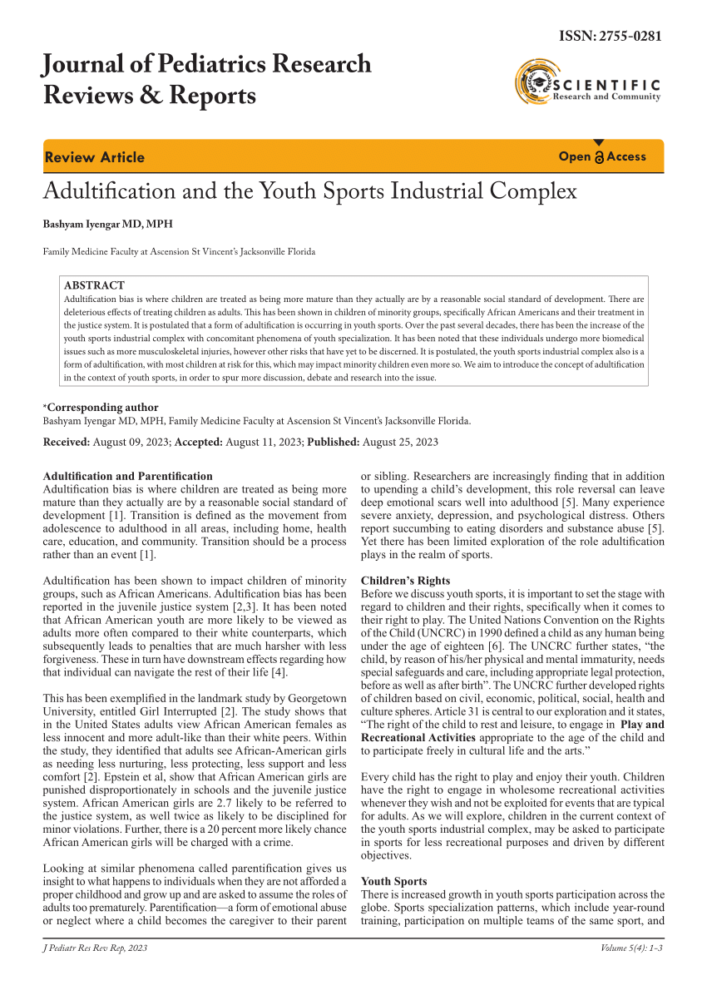

Are we getting in the way?

Slide 9
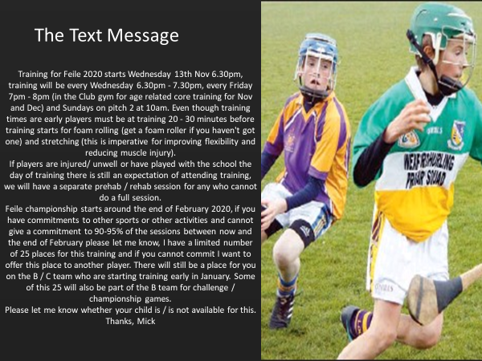

Slide 10
The only team that needs to win trophies is the 1st team. The youth teams don’t need to win, they just need to make their players better
The Ajax Academy Philosophy From ‘stillness and speed, My Story, Dennis Bergkamp

Slide 11
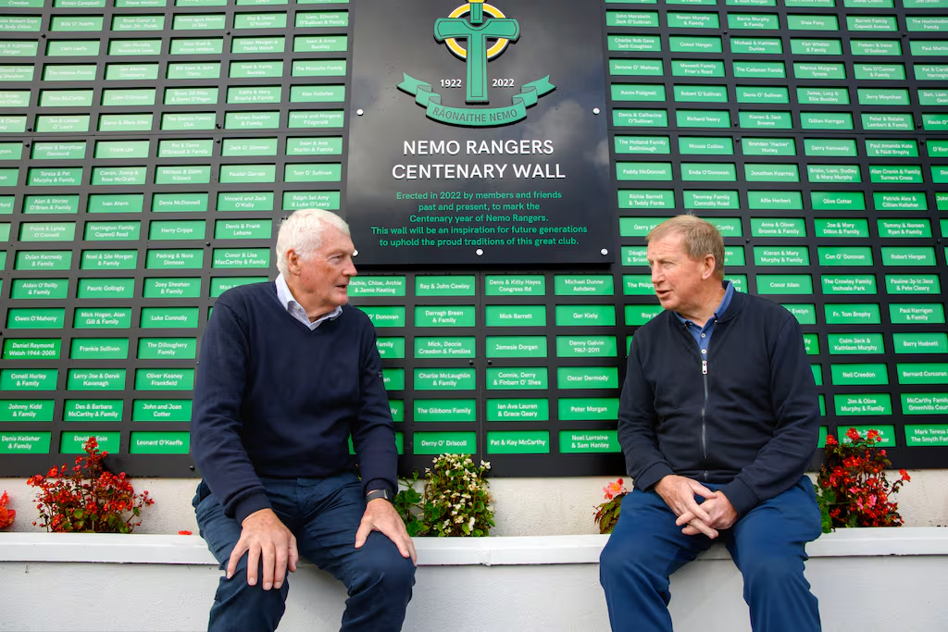
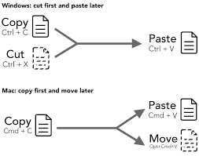
How do some clubs get this right ?

Slide 12
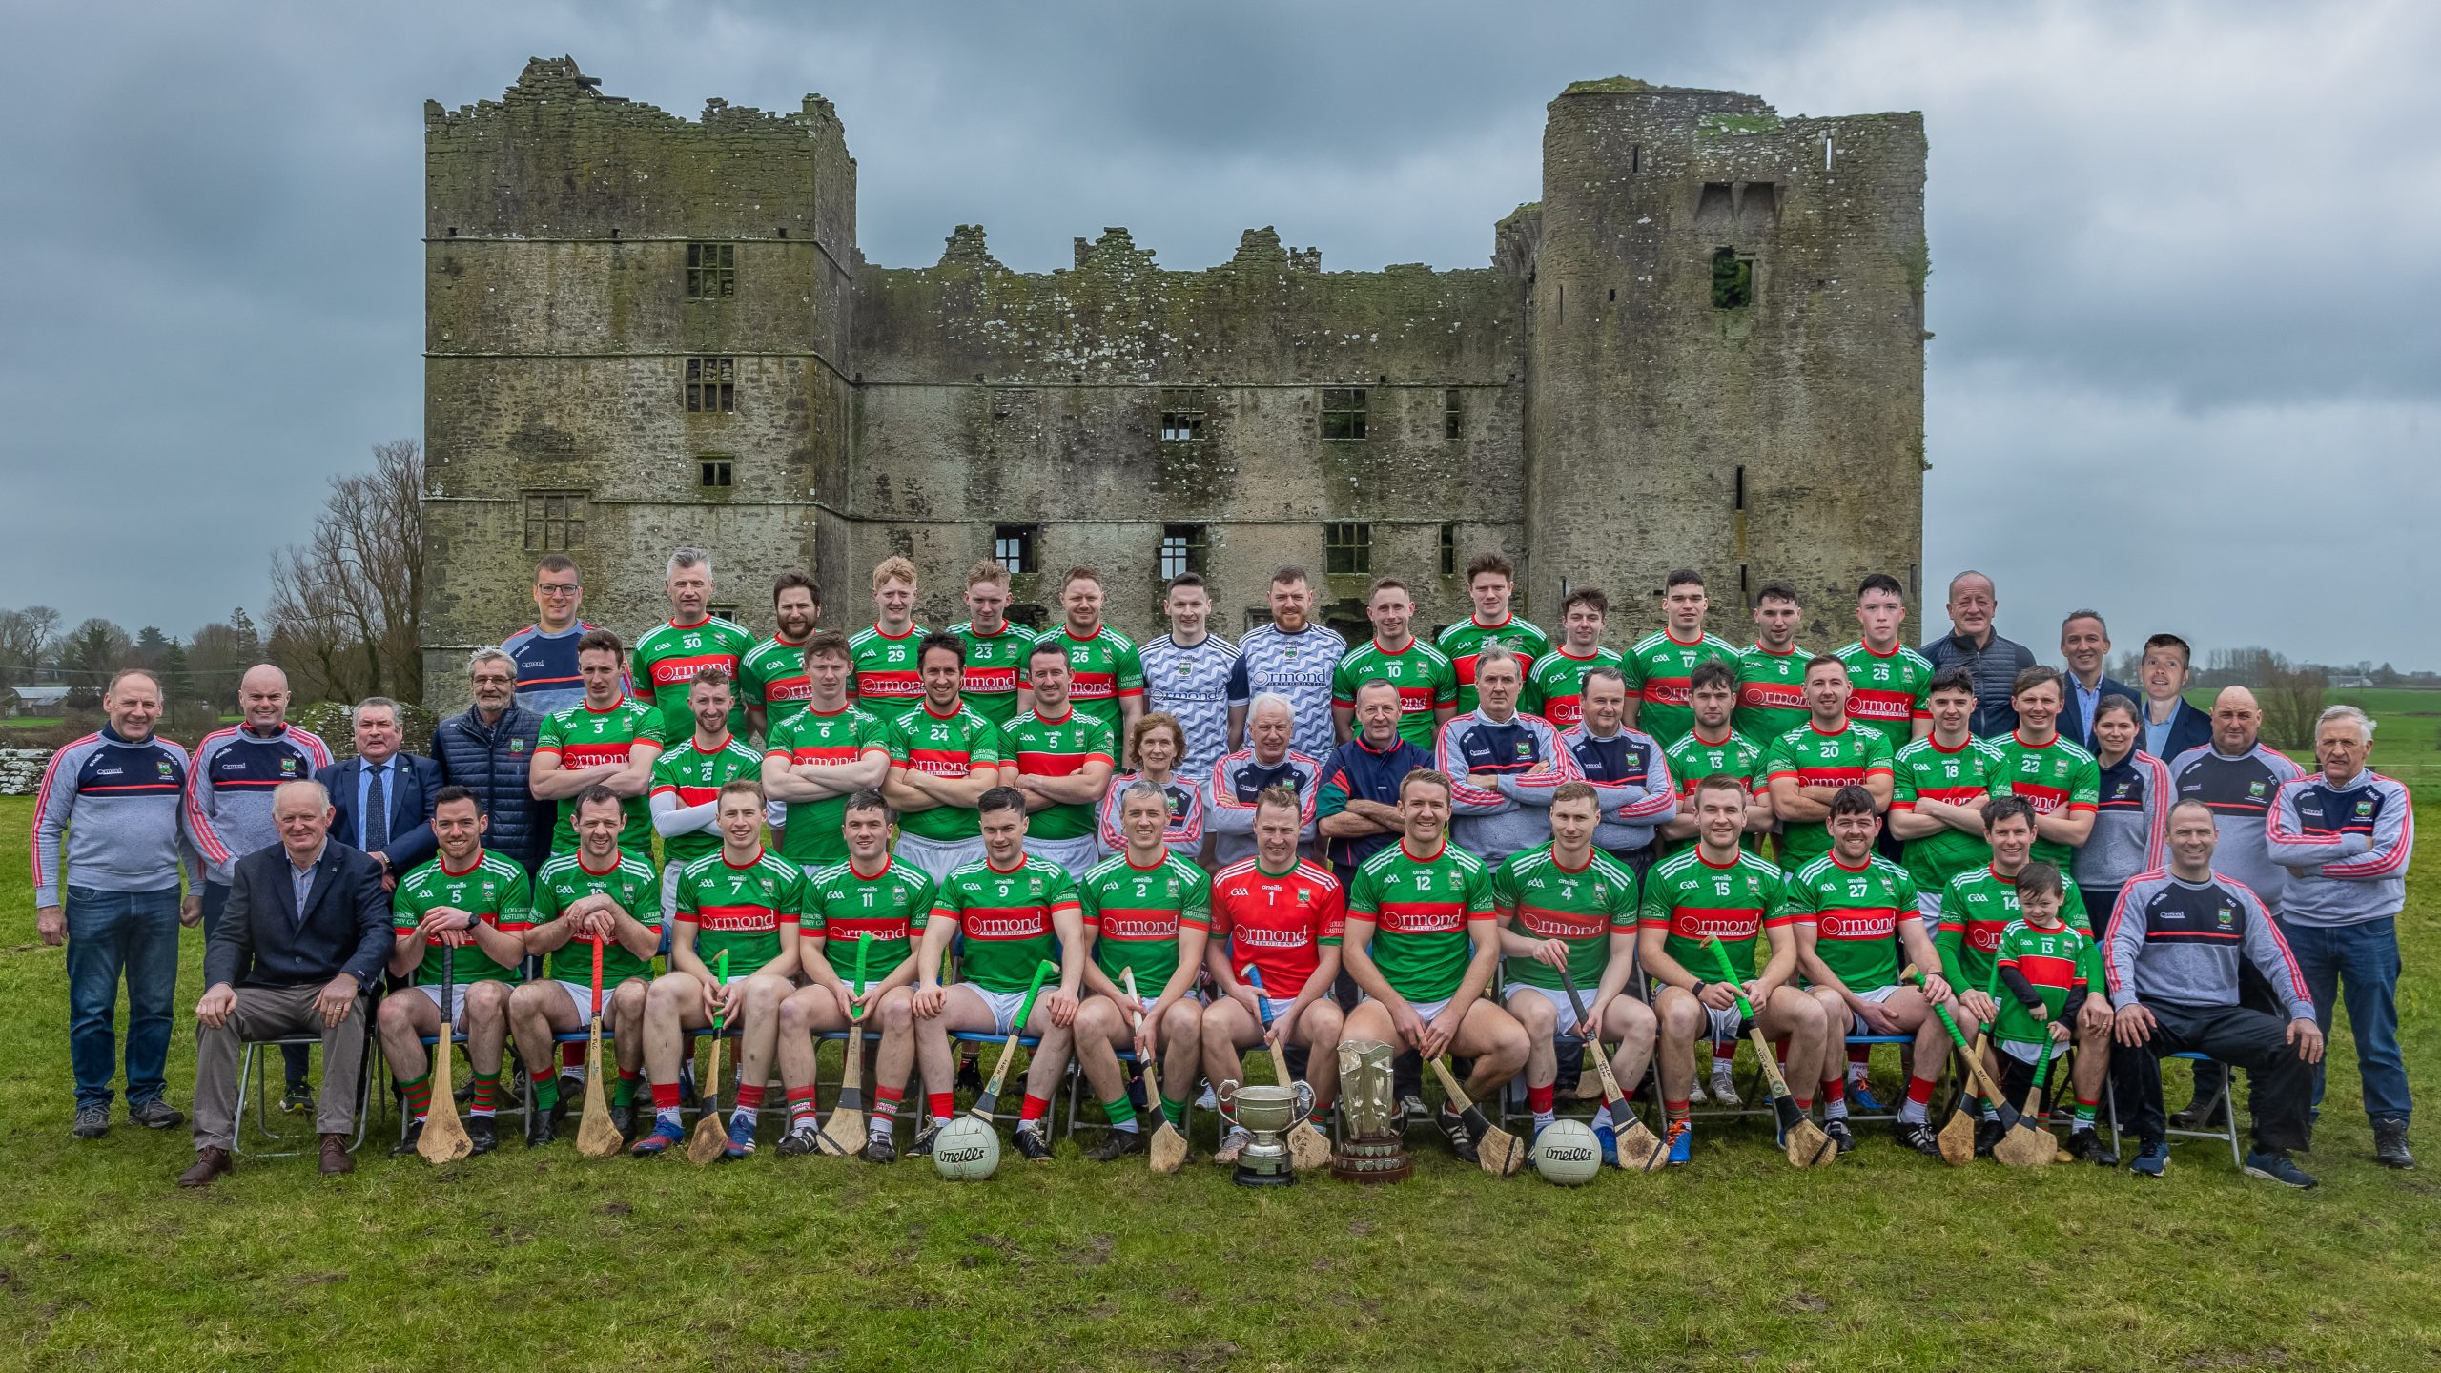
1. They Know …………
Who they are
How they coach
How they play
How they support
How to develop players for the future

Slide 13
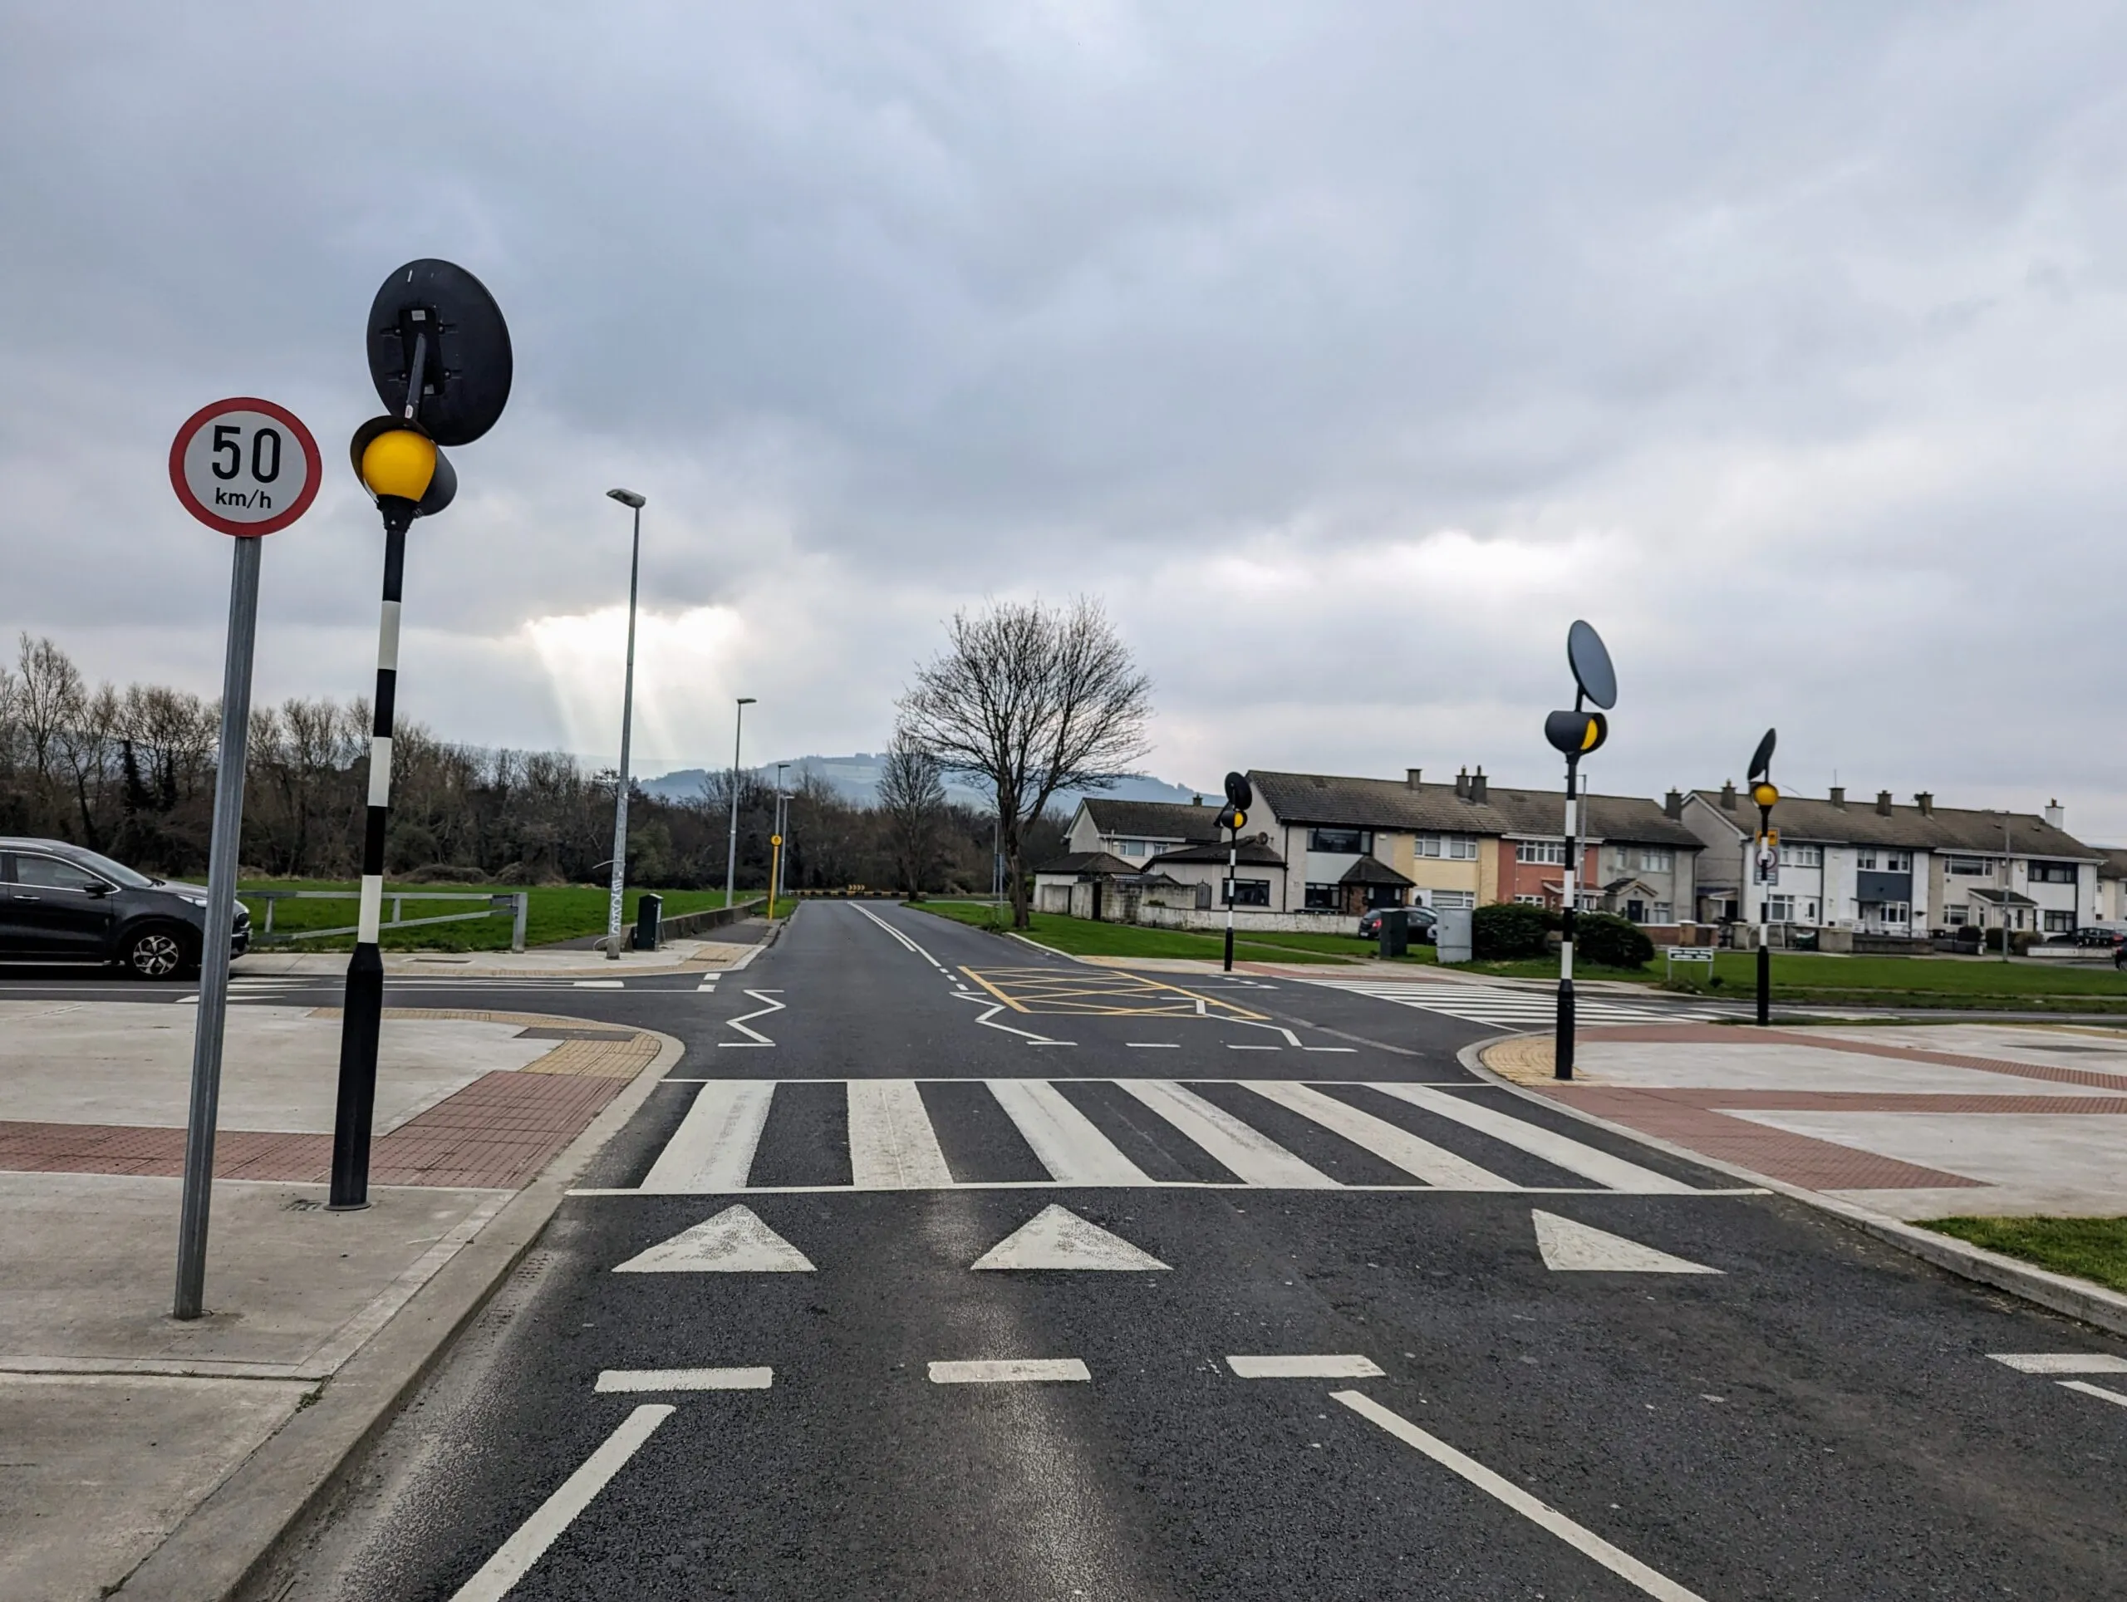
2. They connect with ……..
Their players
The Players’ parents
Their communities
Supportive Relationships are key to developing connection

Slide 14
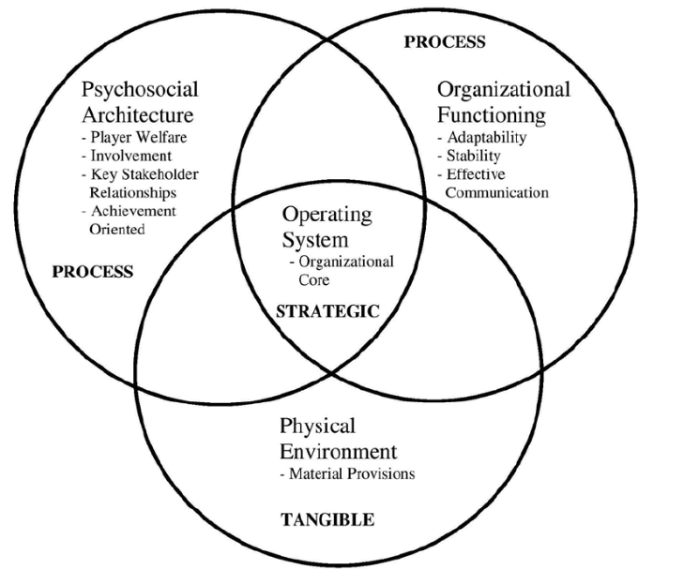
3. They work hard at ………..
The organisational core
Infrastructure
Culture
Processes
Leaving winning take care of itself

Slide 15
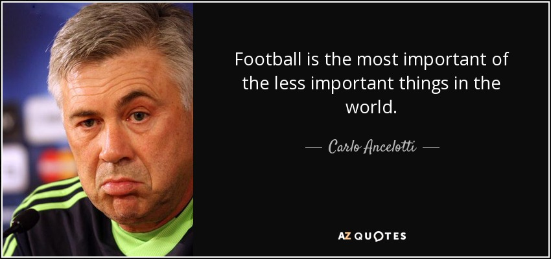
4. They understand that ………
Its not just about hurling and football
That life skills such as leadership, respect, volunteering, giving back are vital ingredients in personal development
Fun is central to sustained involvement

Slide 16

5. They keep the end in mind

Slide 17
Key point
In order to challenge trends and ensure the longevity of our clubs, we must examine the quality of the experiences we provide, as well as the environment in which these experiences occur
We must also examine the changing expectations of our youth in terms of what is on offer at the club

Slide 18
Thank You

