Slide 1
Munster Club Forum
Benny Hurl
Ardboe O’Donovan Rossa bennyhurl@hotmail.com
Ccdelegate.tyrone@gaa.ie
0044 7710 679717

Slide 2
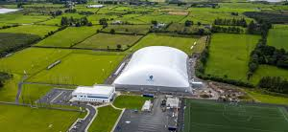
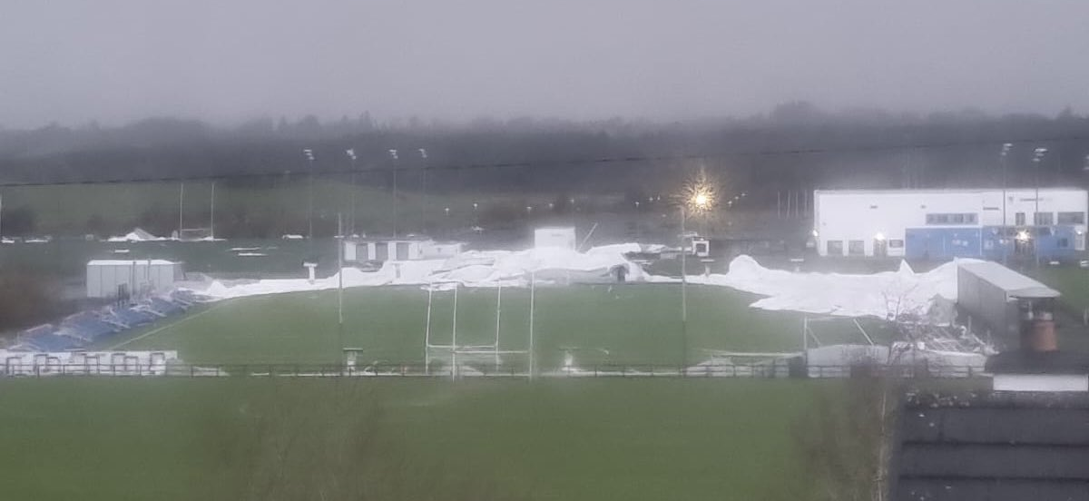
Connacht GAA Dome

Slide 3
Committee Members
Benny Hurl (Tyrone), Chair
Enda Stenson (Leitrim)
Paddy Kelly (Meath)
Liam Lynch (Kerry)
Colm Cummins (Offaly)
Dr. Senan Cooke (Waterford)
Brendan Waters (Dublin)
Katherine Maughan (Mayo)
Conor Weir (Croke Park)
Peter Horgan (Croke Park), Runaí

Slide 4
What is demographics ?
Caused by the movement over a long period of time of people from Rural parts of Ireland into the towns and the cities.
Millions of people from rural Ireland have moved or have been forced to move into urban centres which is having a huge impact on GAA clubs.
This movement happened with limited planning or intervention by the GAA.
No real change in the number of clubs now in urban and rural spaces despite the population shifts.
Many Rural clubs have got much smaller – some urban clubs have become drastically bigger and are in some cases too big. Other urban clubs under huge pressure.

Slide 5
Number of Births 2010 - 2023

Slide 6
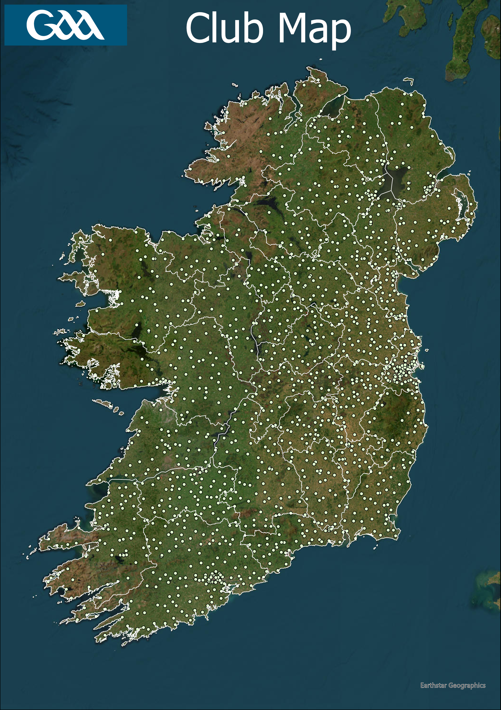
Total Population: 7,052,602
Total Clubs:
1,610

Slide 7
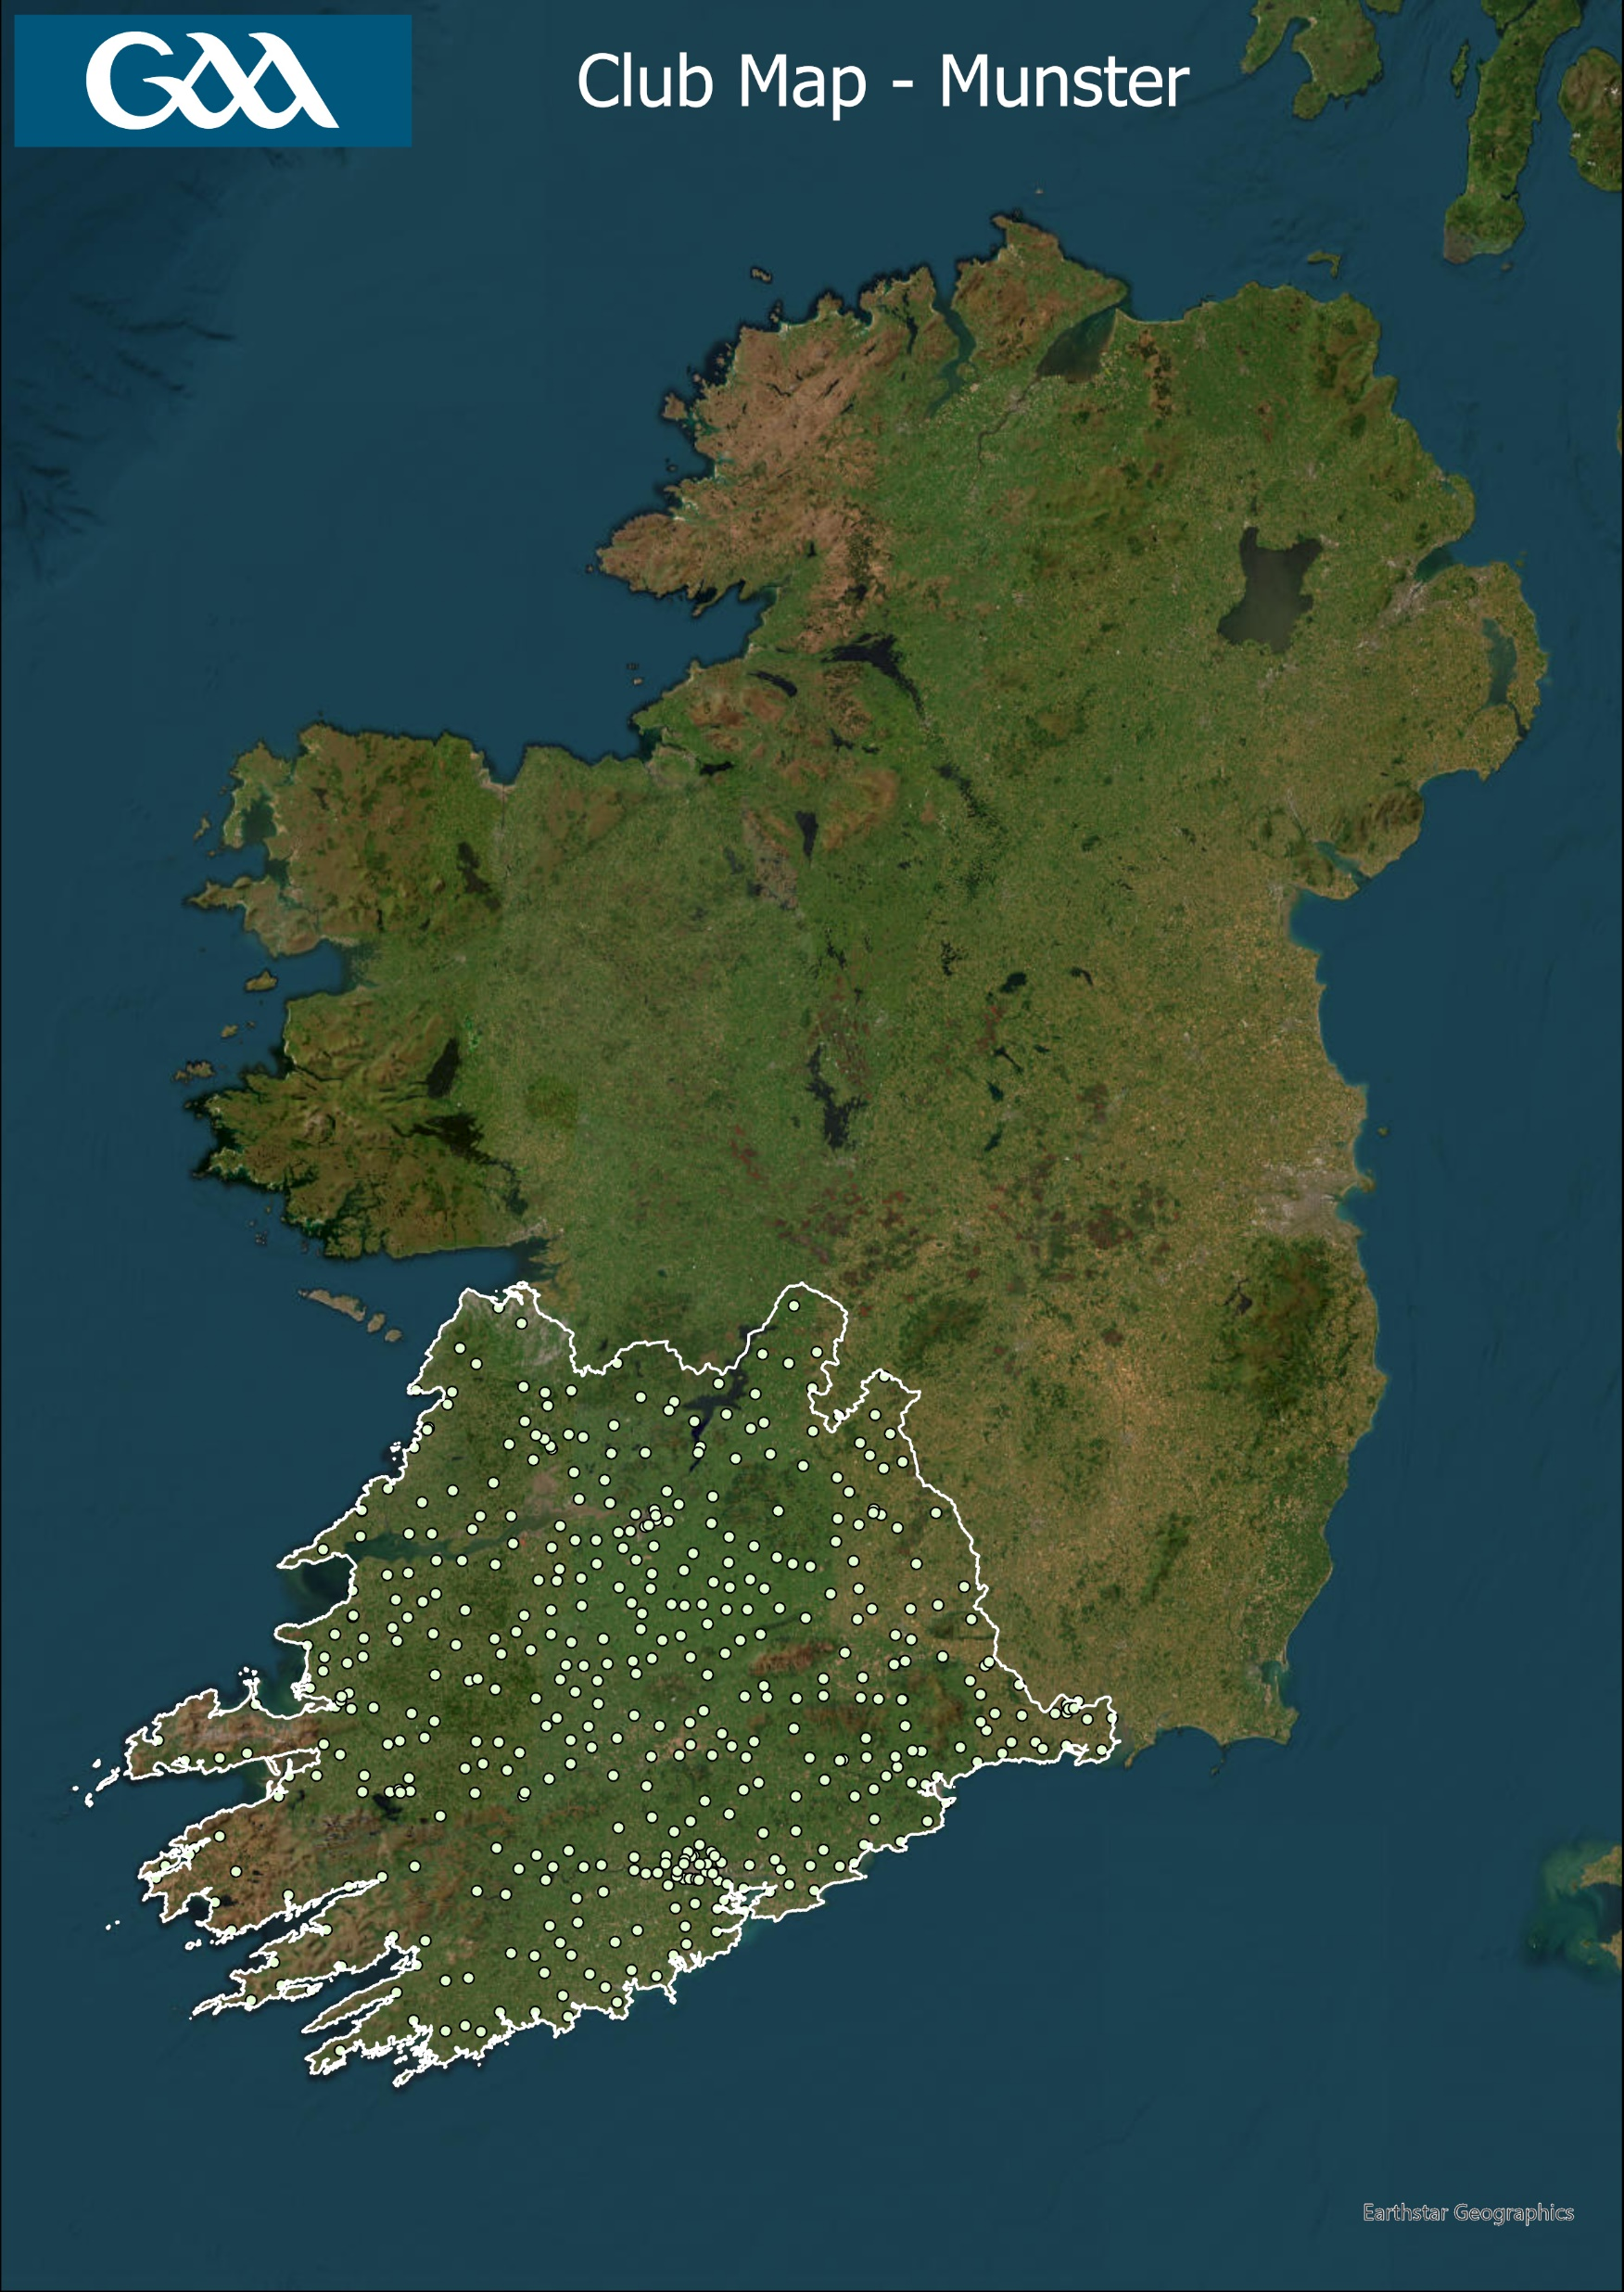
Population: 1,373,346
% of Total Population: 19.4 %
Clubs: 463
% of Total Clubs: 28.8 %
Members: 137,640
% of Total Members: 25 %

Slide 8
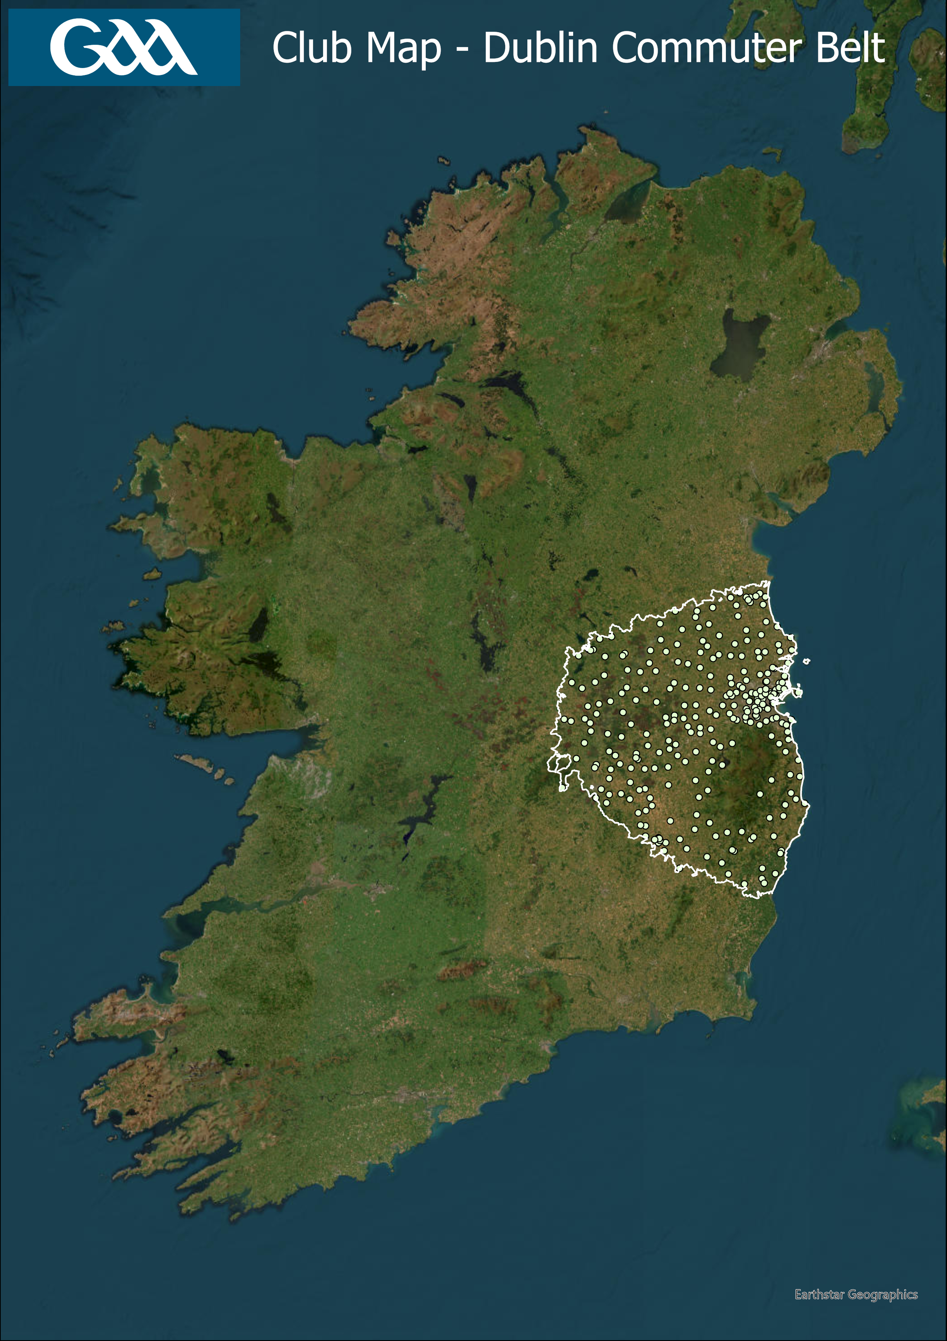
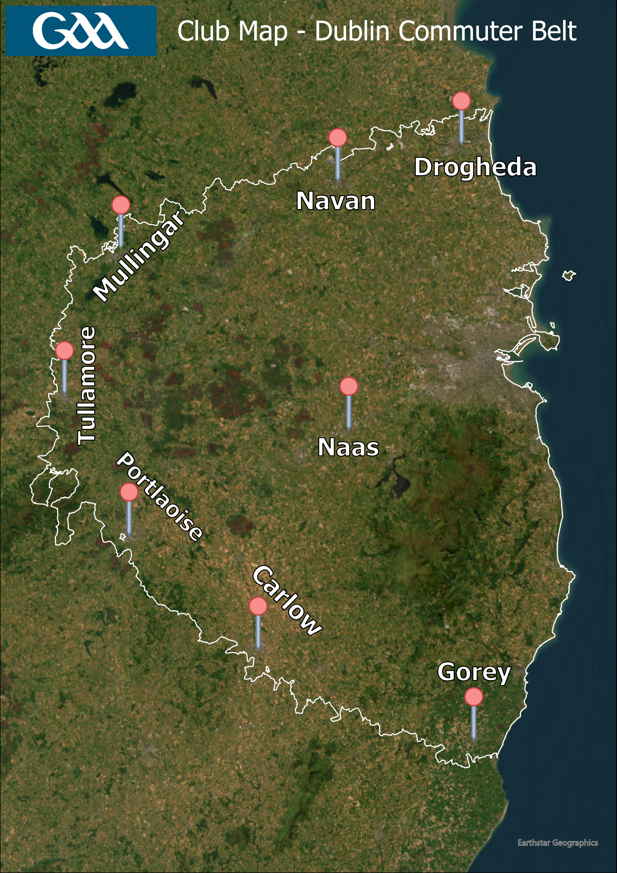
Population: 2,304,899
% of Total Population: 32.7 %
Clubs: 290
% of Total Clubs: 18 %

Slide 9
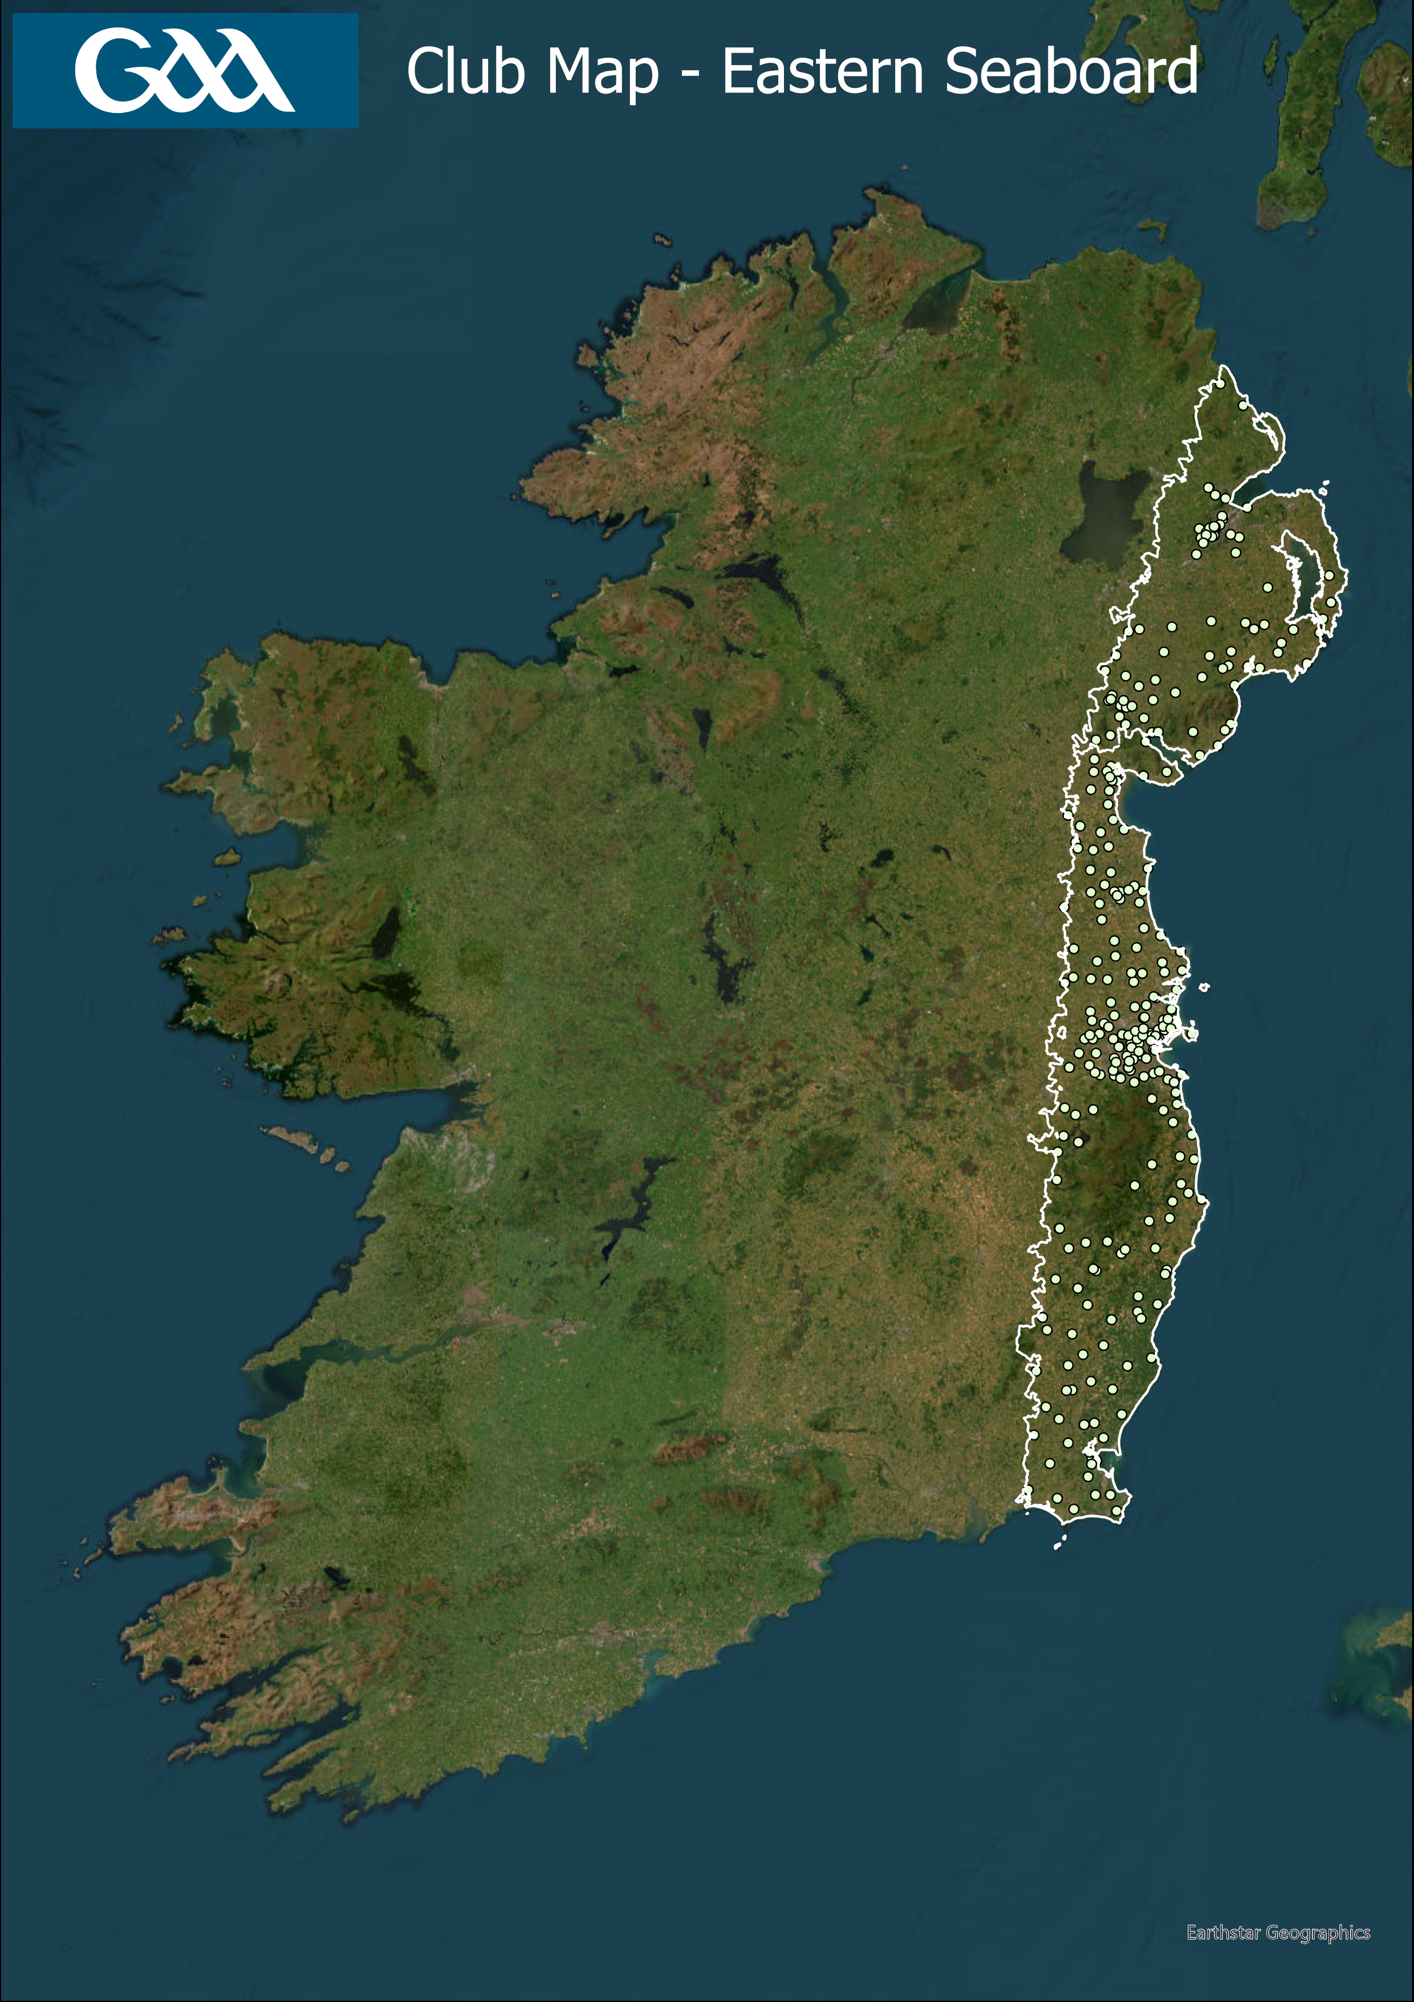
Population: 3,071,222
% of Total Population: 43.5 %
Clubs: 299
% of Total Clubs: 18.6 %

Slide 10
What conclusions can we draw?
Current GAA structures are not working for many clubs and counties who are experiencing demographic change.
Old ways have served us well but Ireland is a very different place now. Change is needed.
Demographics is not exclusively a rural issue. Arguably the urban issues are greater. Young people have so many other options to choose from. GAA are competing for players with other sports / pursuits. QUESTION

Slide 11
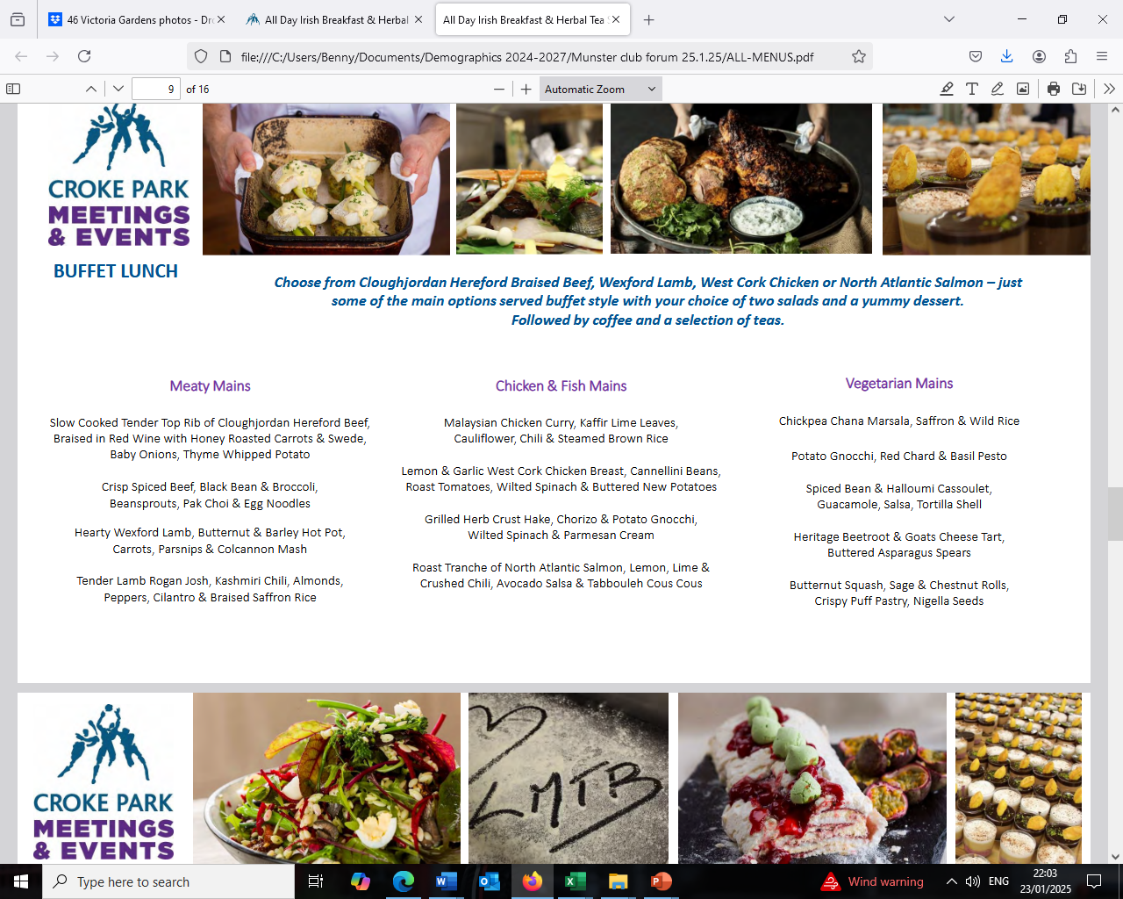
Menu of options

Slide 12
Menu from which each county can select from according to their needs:
Additional divisions at underage and adult level leagues and championships giving clubs an opportunity to compete against teams of a similar level.
Intercounty hurling has multiple levels which work brilliantly. The same can work at club level. QUESTION
Can we get more people to play by having greater flexibility in our transfer rules ?
Can we introduce permissions / sanctions to play from urban to rural ?.
Cross county / provincial games based on the Táin Óg principles
Smaller sided games to allow clubs to field independently.
Redefine club to suit needs of under pressure clubs.

Slide 13
Practical help and support for clubs
Develop a Club and County Support Unit (Centrally and Provincially based)
  Designed to provide guidance, resources, and assistance to clubs.
  To ensure the sustainable growth and efficient management of clubs and counties.
      Help with club creation, maintenance, and retention
      Identify areas for strategic development of new clubs
      Advice on access to local and national governments
      Advice on contributing to future local area development plans
      Advice on sourcing and accessing grant aid
      Advice on Social Enterprises
      Job creation / matching programme
      Aim to grow membership as we approach 2034

Slide 14
Proposed External Actions
External Government / Council Engagement
  Rural and urban planning
  Development of Social Enterprises ( Senan Cooke, Dunhill an expert in this area ).
  Development of Urban Facilities
  Access to funding
  Job creation
  Partnerships
  GAA counties and clubs find it difficult to engage with councils, agencies, governments and government departments – we need enablers.

Slide 15
Maybe some harm is self inflicted in the pursuit of winning ? We must shoulder some responsibility ourselves.
Can you make a difference as coaches and administrators in your clubs in the short term to recruit and retain more players who will become the future volunteers ?

Slide 16
What is the priority ? Short term gain or retaining more players ?
Everywhere we go all we hear is about High-Performance Environments.
Clubs are jumping on board the runaway train, doing all they can to make sure they win that league or championship.
Research survey proves that young people will give up if they do not enjoy their hobbies / sports.
Pressure cooker environment. Commitment too great. Demands too high.
Create a fun environment whilst being ambitious and giving your all.

Slide 17
TAKE HOME MESSAGE
We realise that major changes are needed if all of YOUR clubs and communities are going to continue to survive and thrive. YOU can positively influence this and make it happen. Will there be a place for all of us and will we along belong ?

Slide 18
Go raibh míle maith agaibh

